Slide 1
From Biological Neurons to Artificial Neural Networks
James M. Irving, Ph.D.
Updated 10/19/20

Slide 2
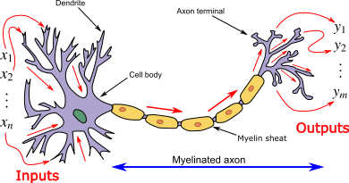
TOPICS TO COVER
Anatomy of a Neuron
How Neurons Process Info
Strengthening / Weakening Connections

Slide 3
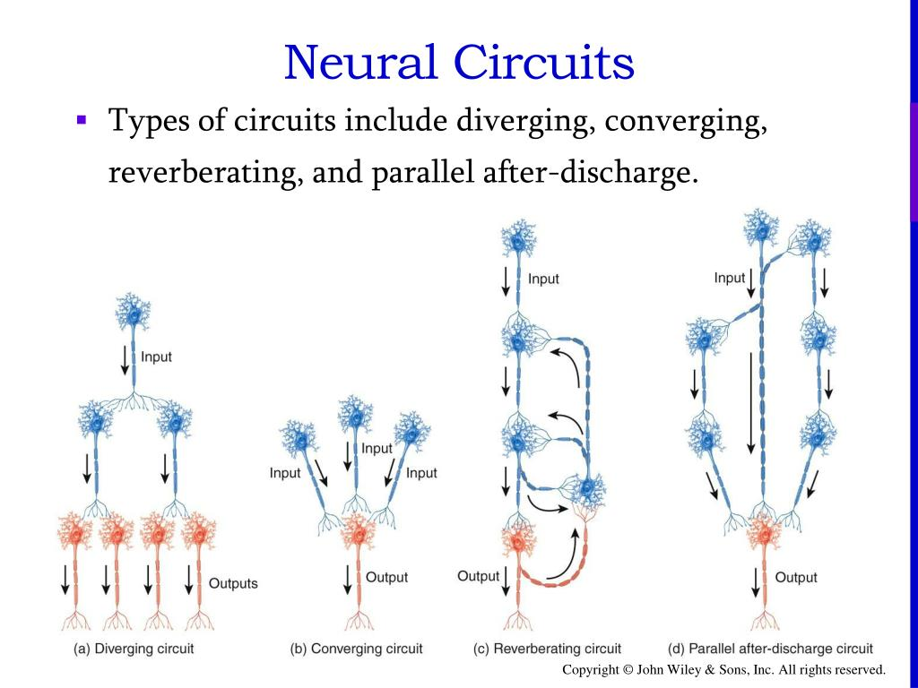
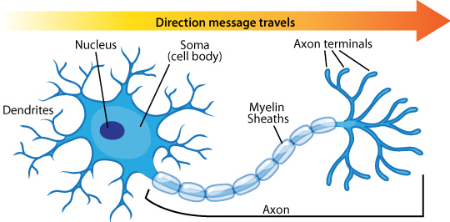
Anatomy of a Neuron I
Neurons are shaped kind of like a tree.
There are branches with leaves at the top (the dendrites/soma)
It has a long trunk (the axon)
The trunk ends with roots that connect to other neurons (the axon terminals)

Slide 4
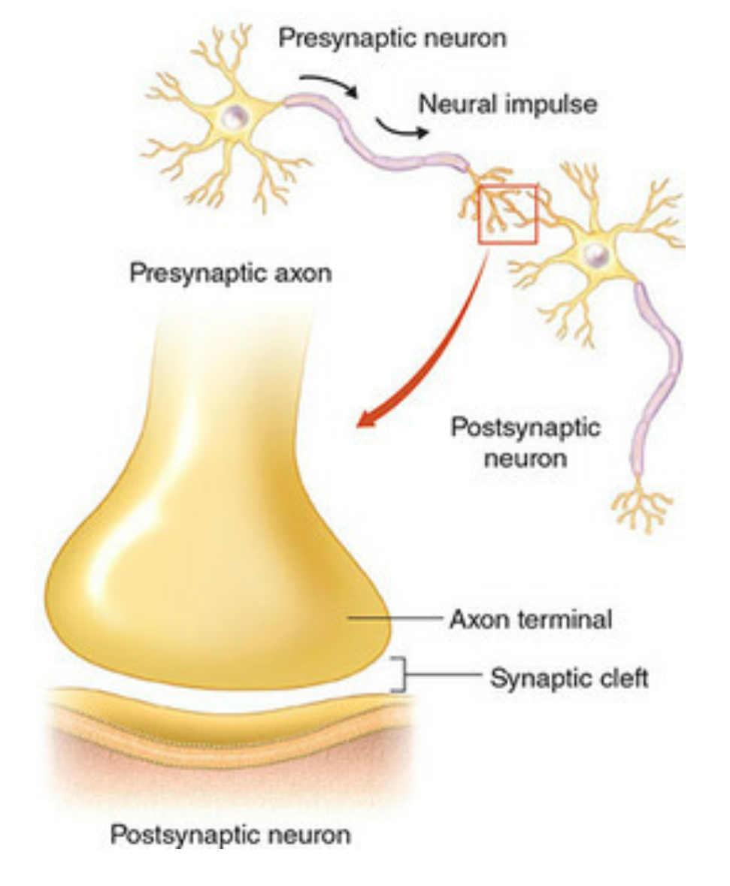
Anatomy of a Neuron II
Lots of neurons (hundreds-thousands) act as Inputs to the neuron by connecting to the neuron’s branches.
These are called “synapses”
Neurons released Neurotransmitters to send information across a synapse

Slide 5
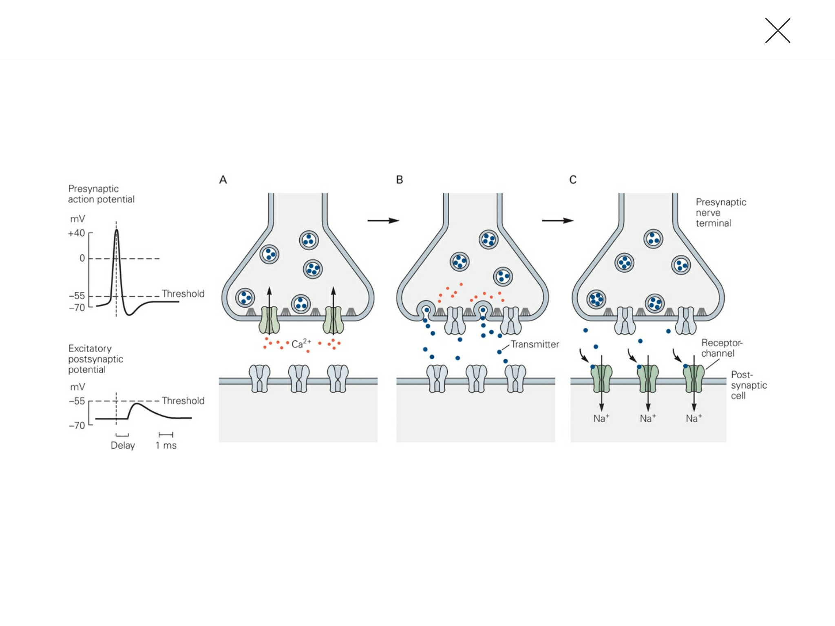
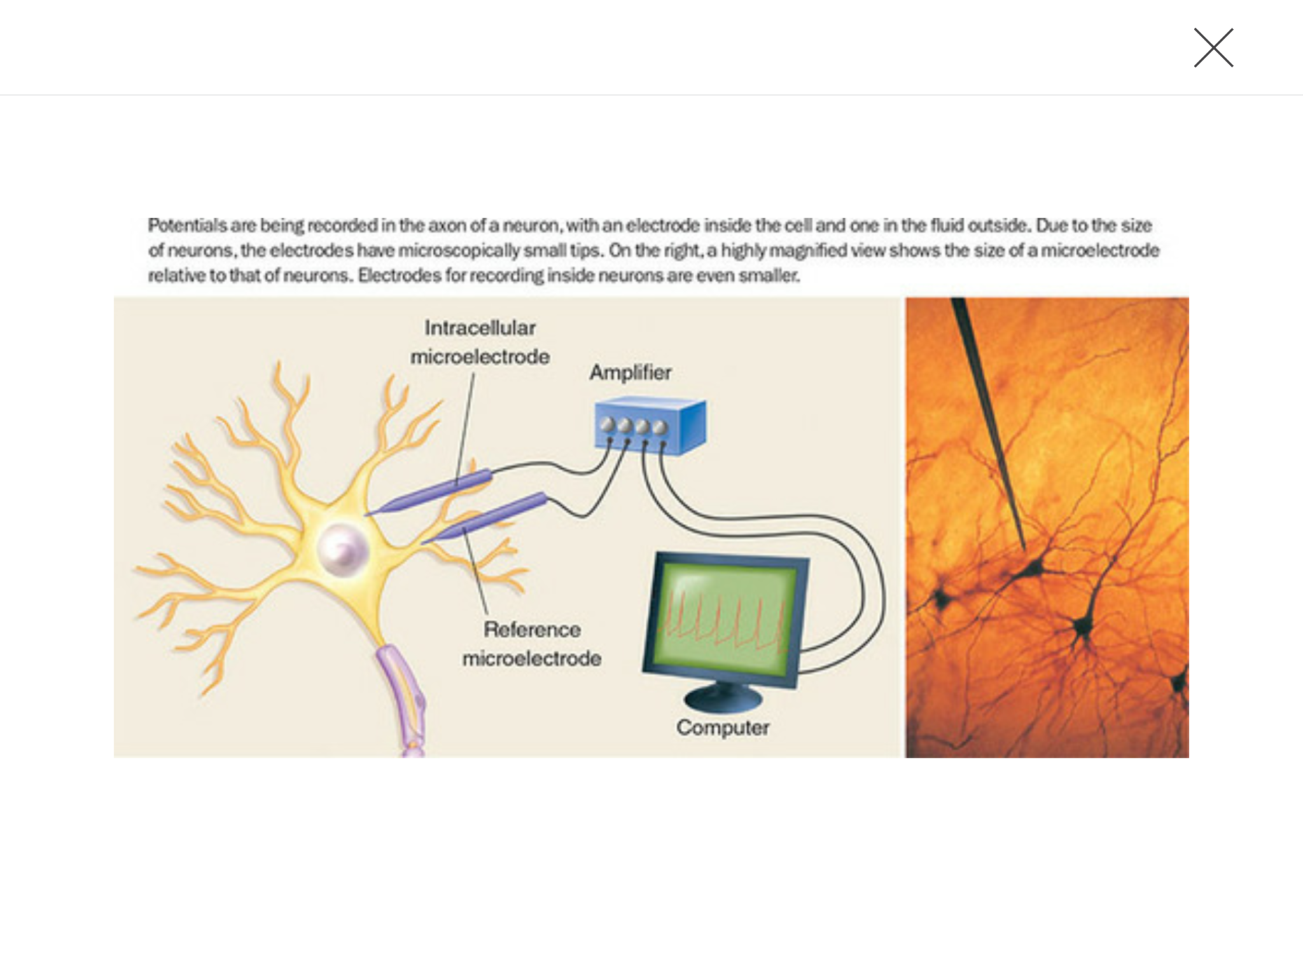
How Neurons communicate

Slide 6
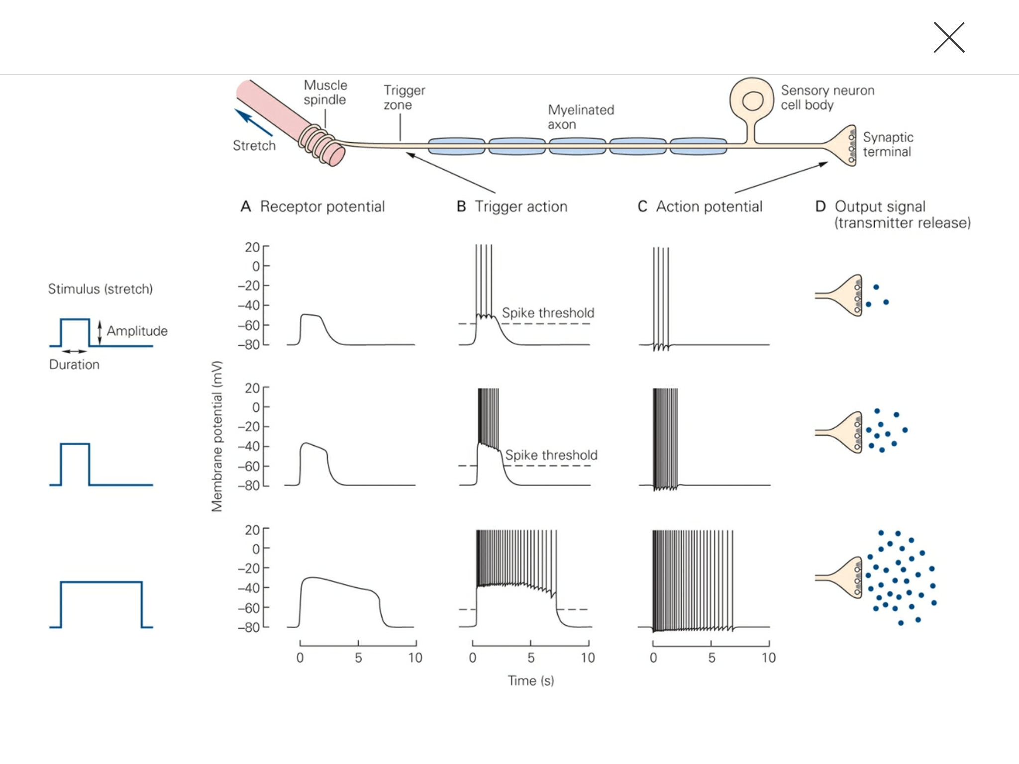
Example Information Processing

Slide 7
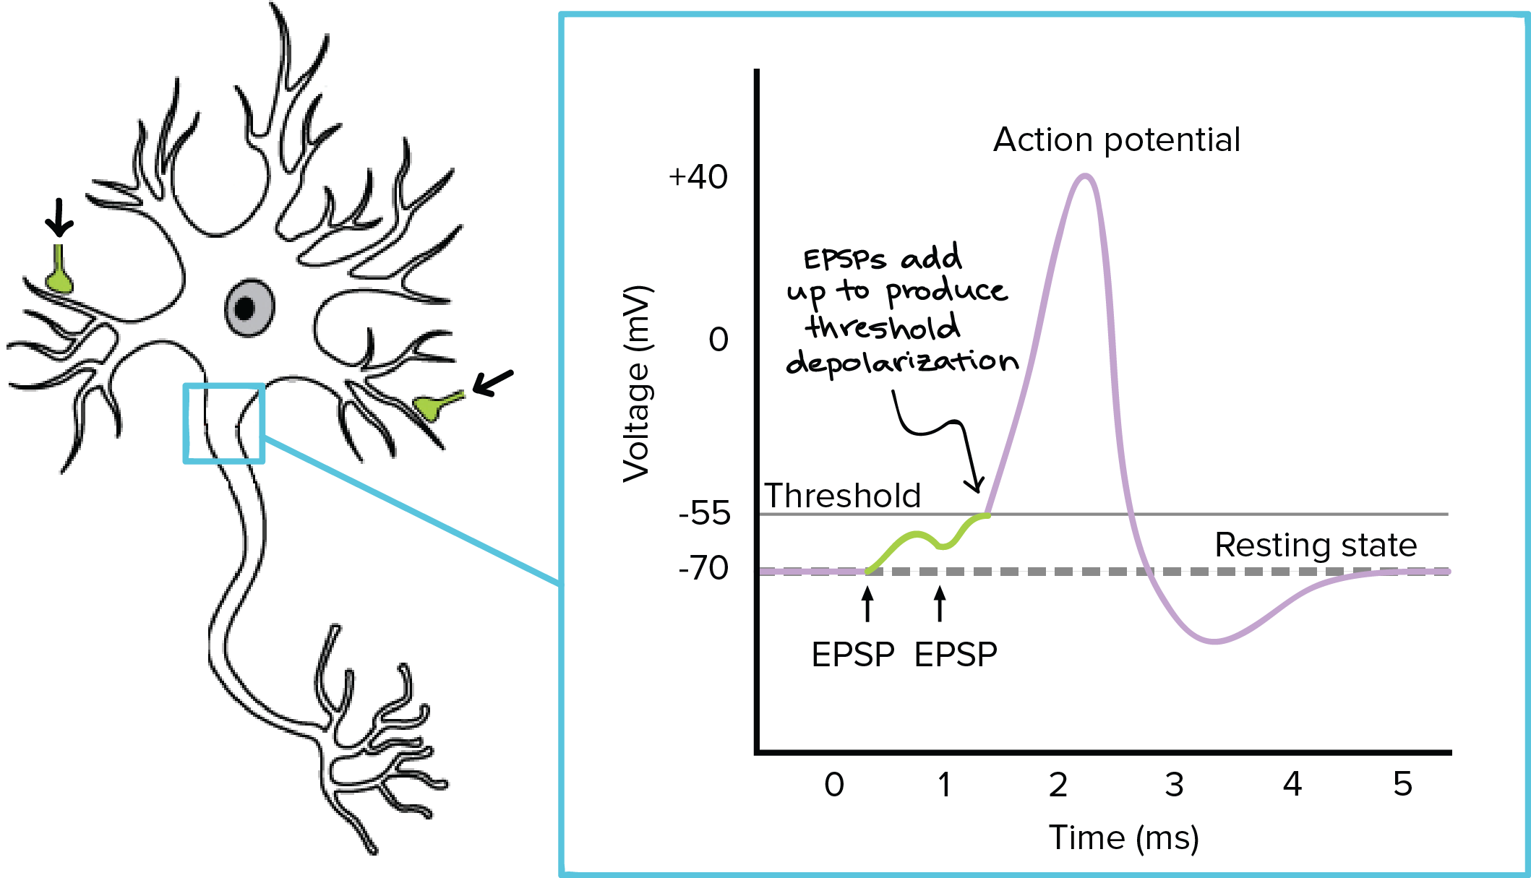
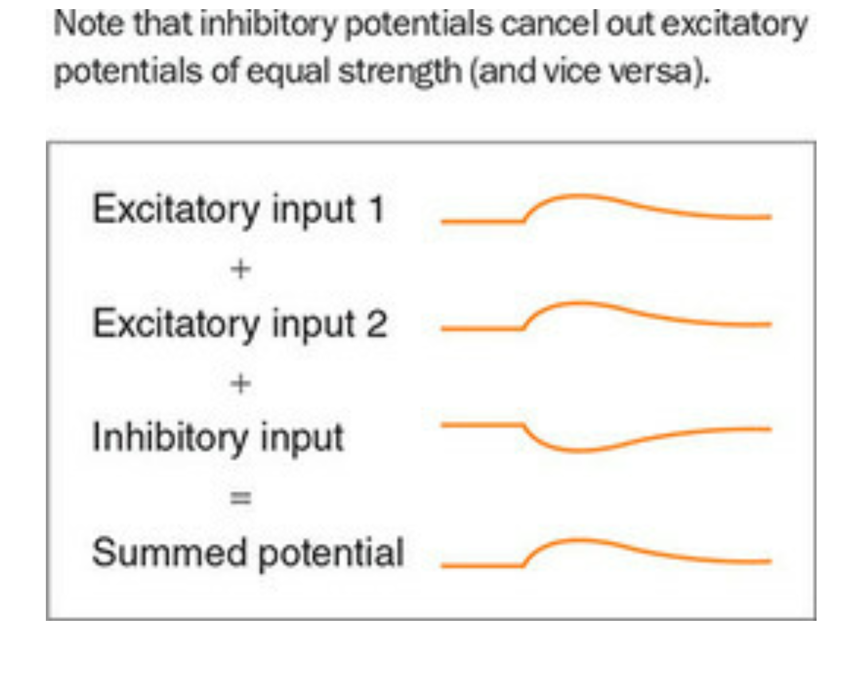
How Neurons Process Information

Slide 8
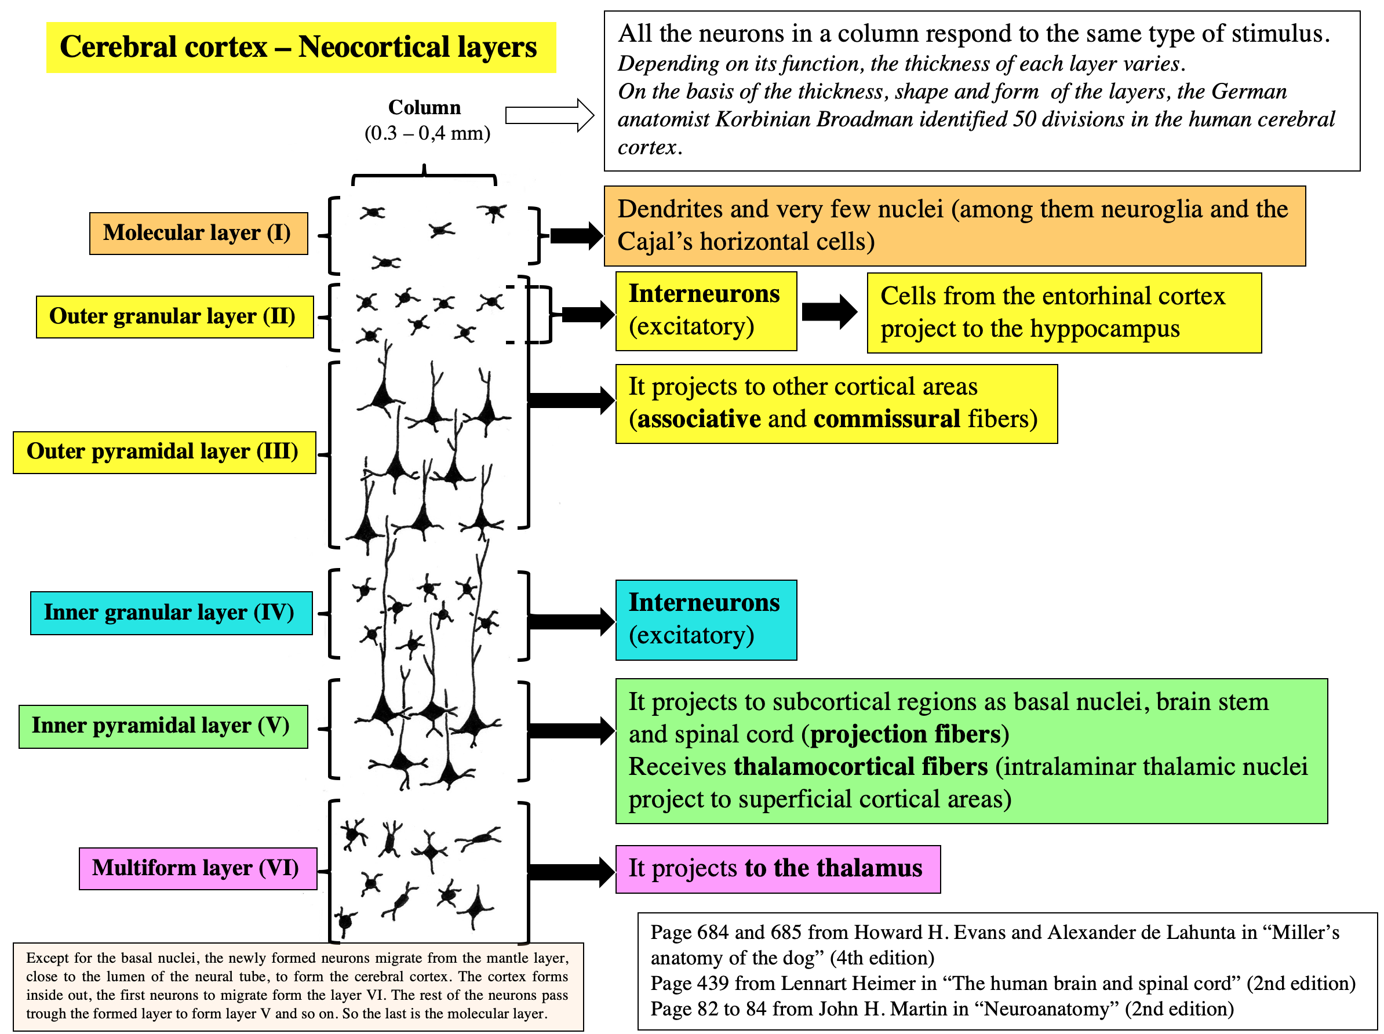
Neurons are Organized into Networks

Slide 9
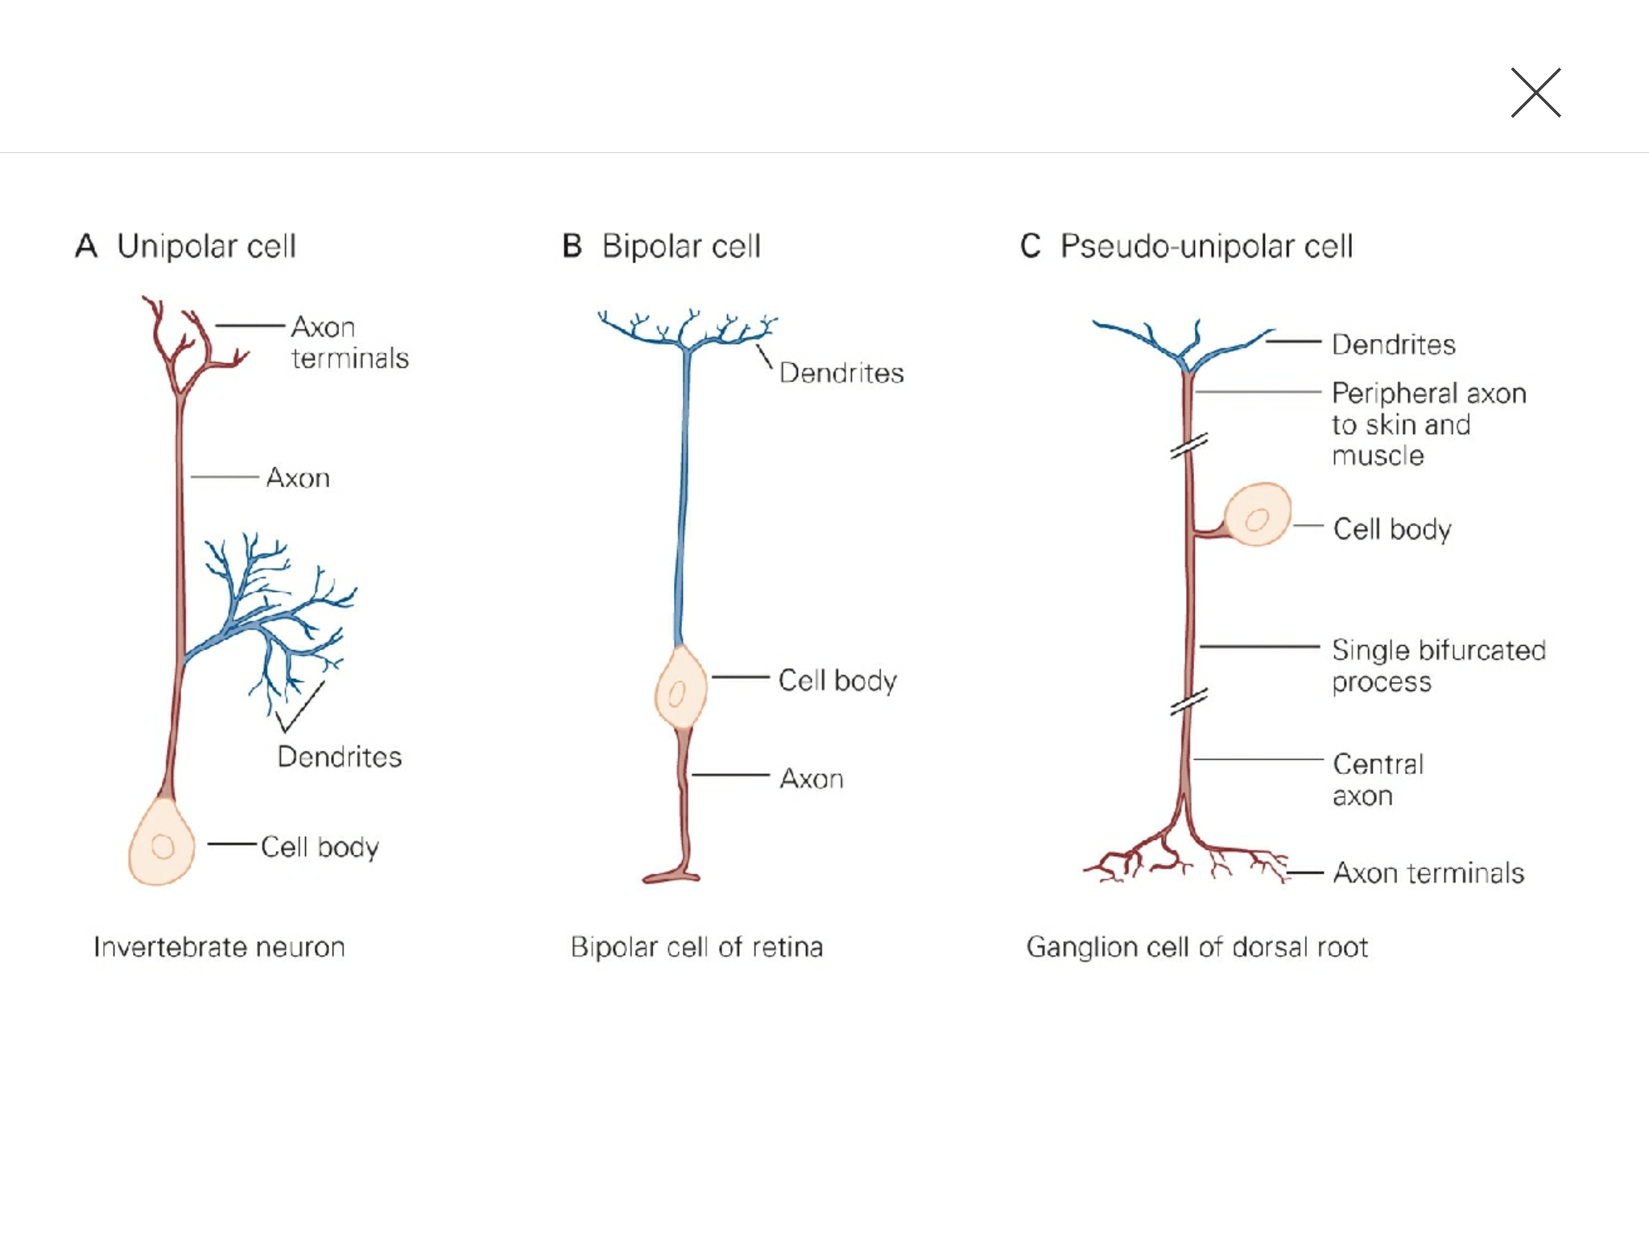
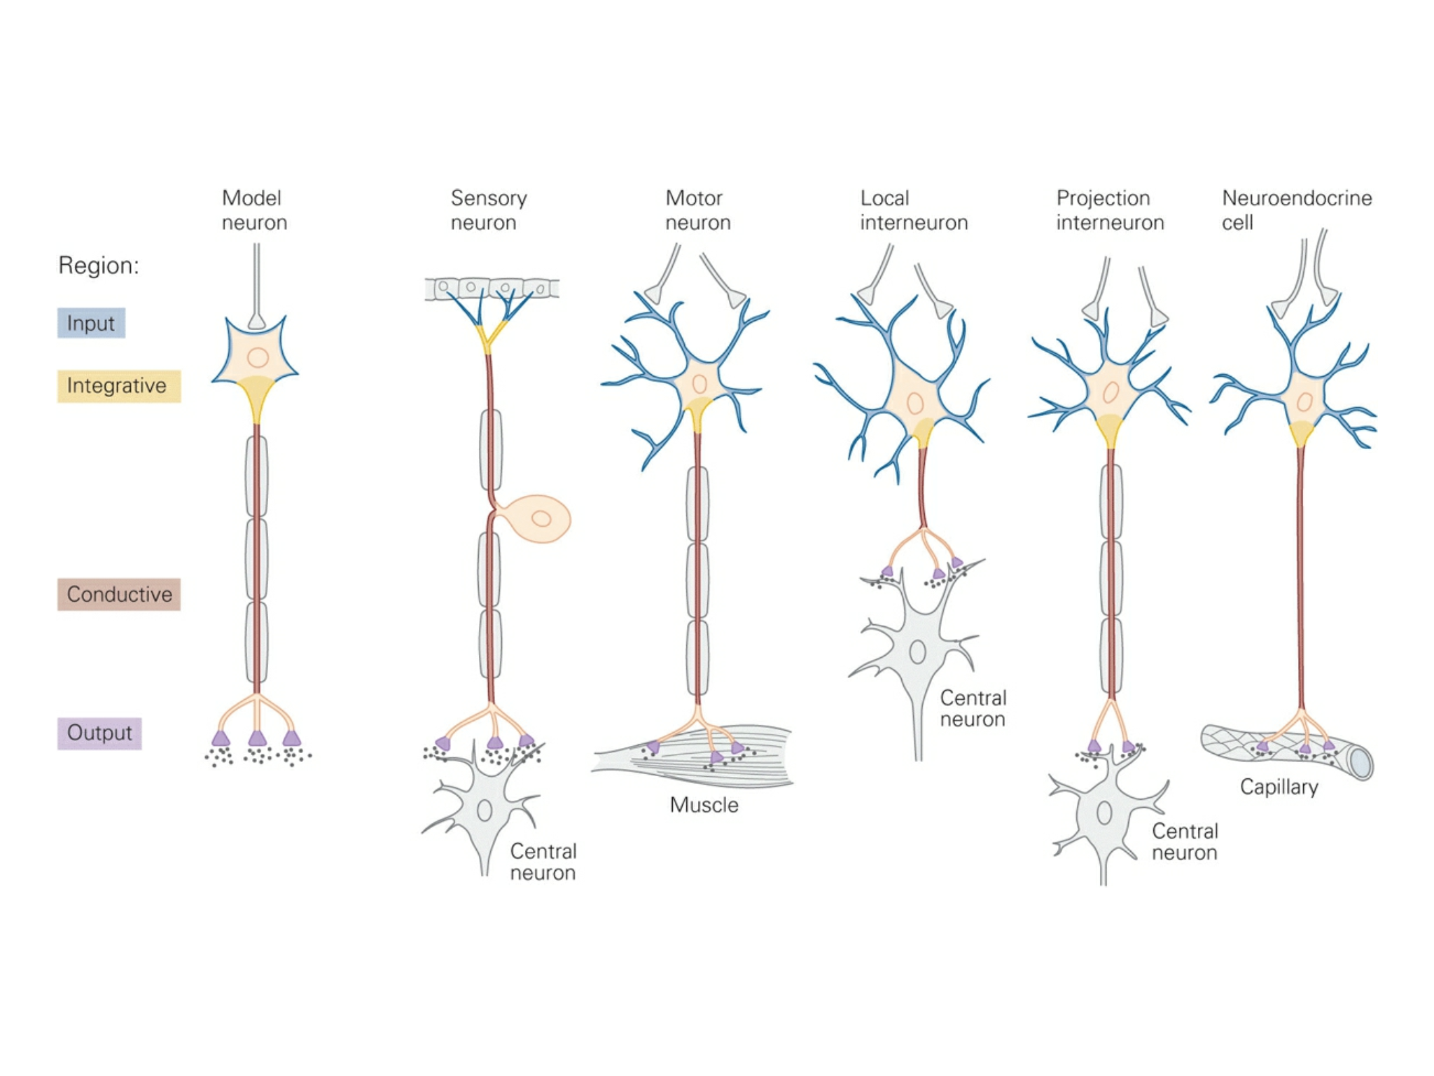
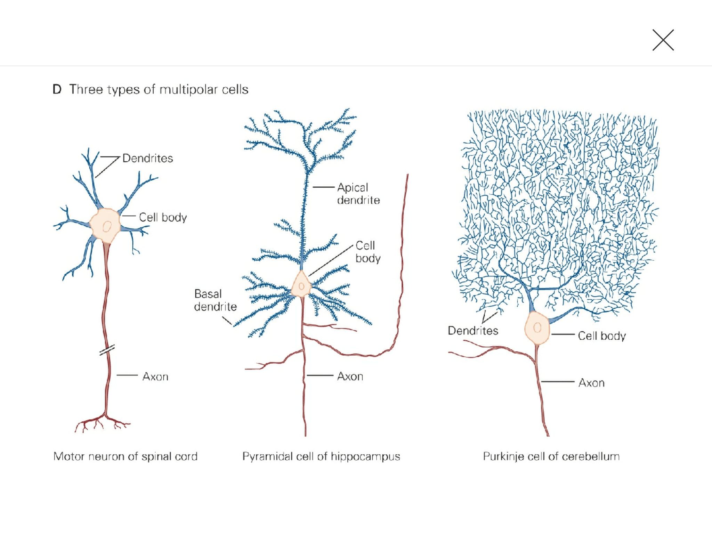
Many Types of Neurons

Slide 10
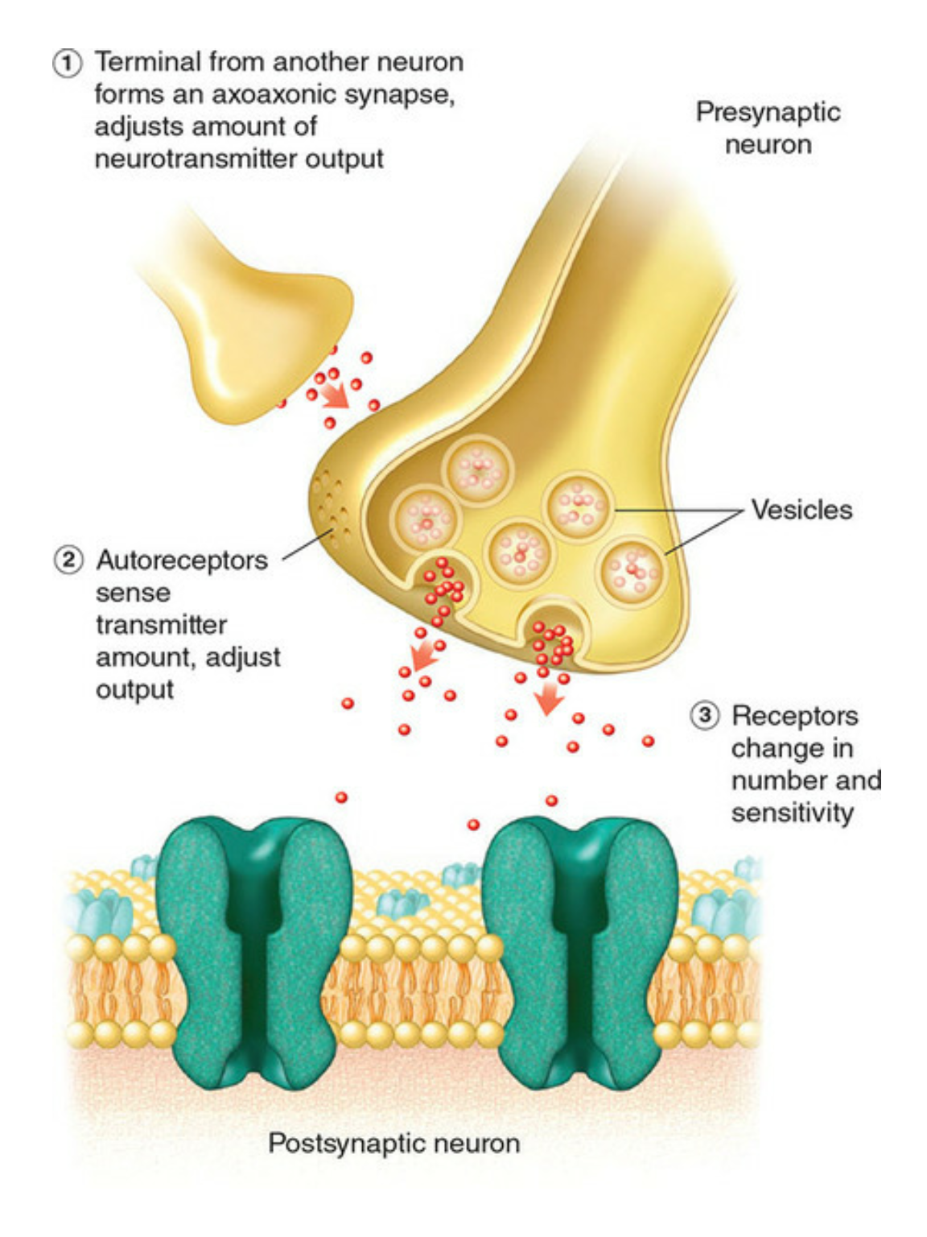
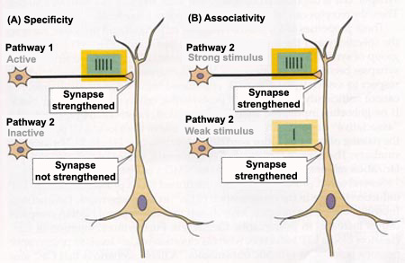
Strengthening of Connections
Neuroplasticity: “Cells that fire together wire together.”
Cells that interact strongly will make their connection stronger.

Slide 11
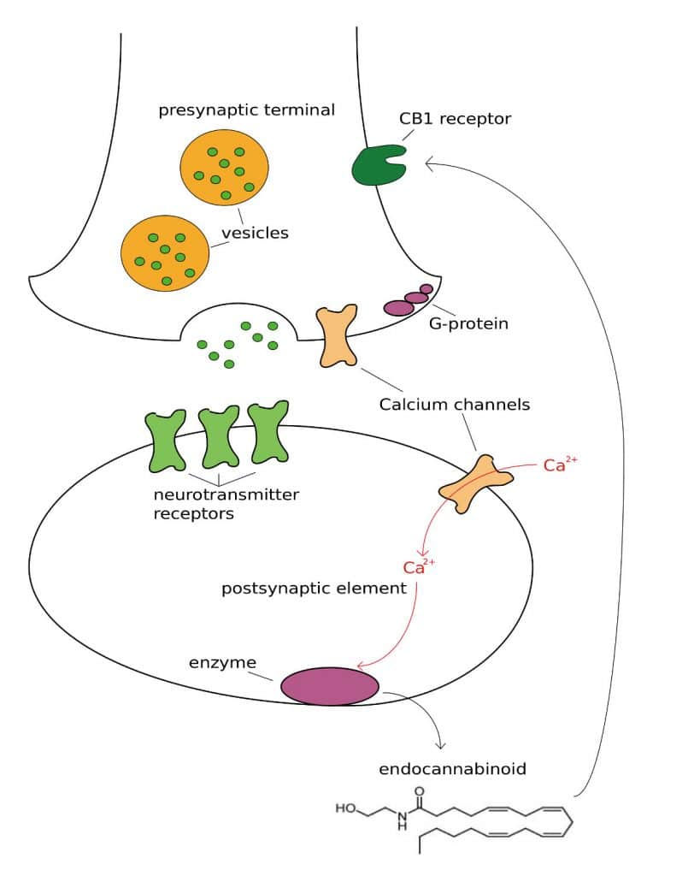
Weakening of Connections / Negative Feedback
Weakly/poorly activated neurons will weaken their connections

Slide 12
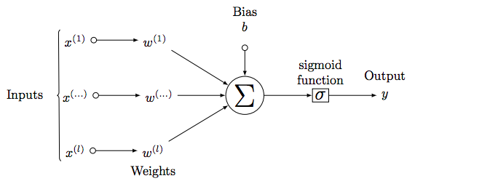
From Bio to Artificial
Artificial Neural Networks mimic the activity of bio neurons:
They take in lots of inputs from other neurons.
They sum up the input signal inside their cell bodies and then depending on the signal and then pass that message onto the next neurons.
The different properties of the cells (like activation functions) result in different information being shared.

Slide 13
Now Back to the Notebook…

Slide 14
Part 2: How Neurons “Learn”
For Section 41: Deeper Neural Networks
05/26/20

Slide 15
Anatomy of a Neuron II

Slide 16
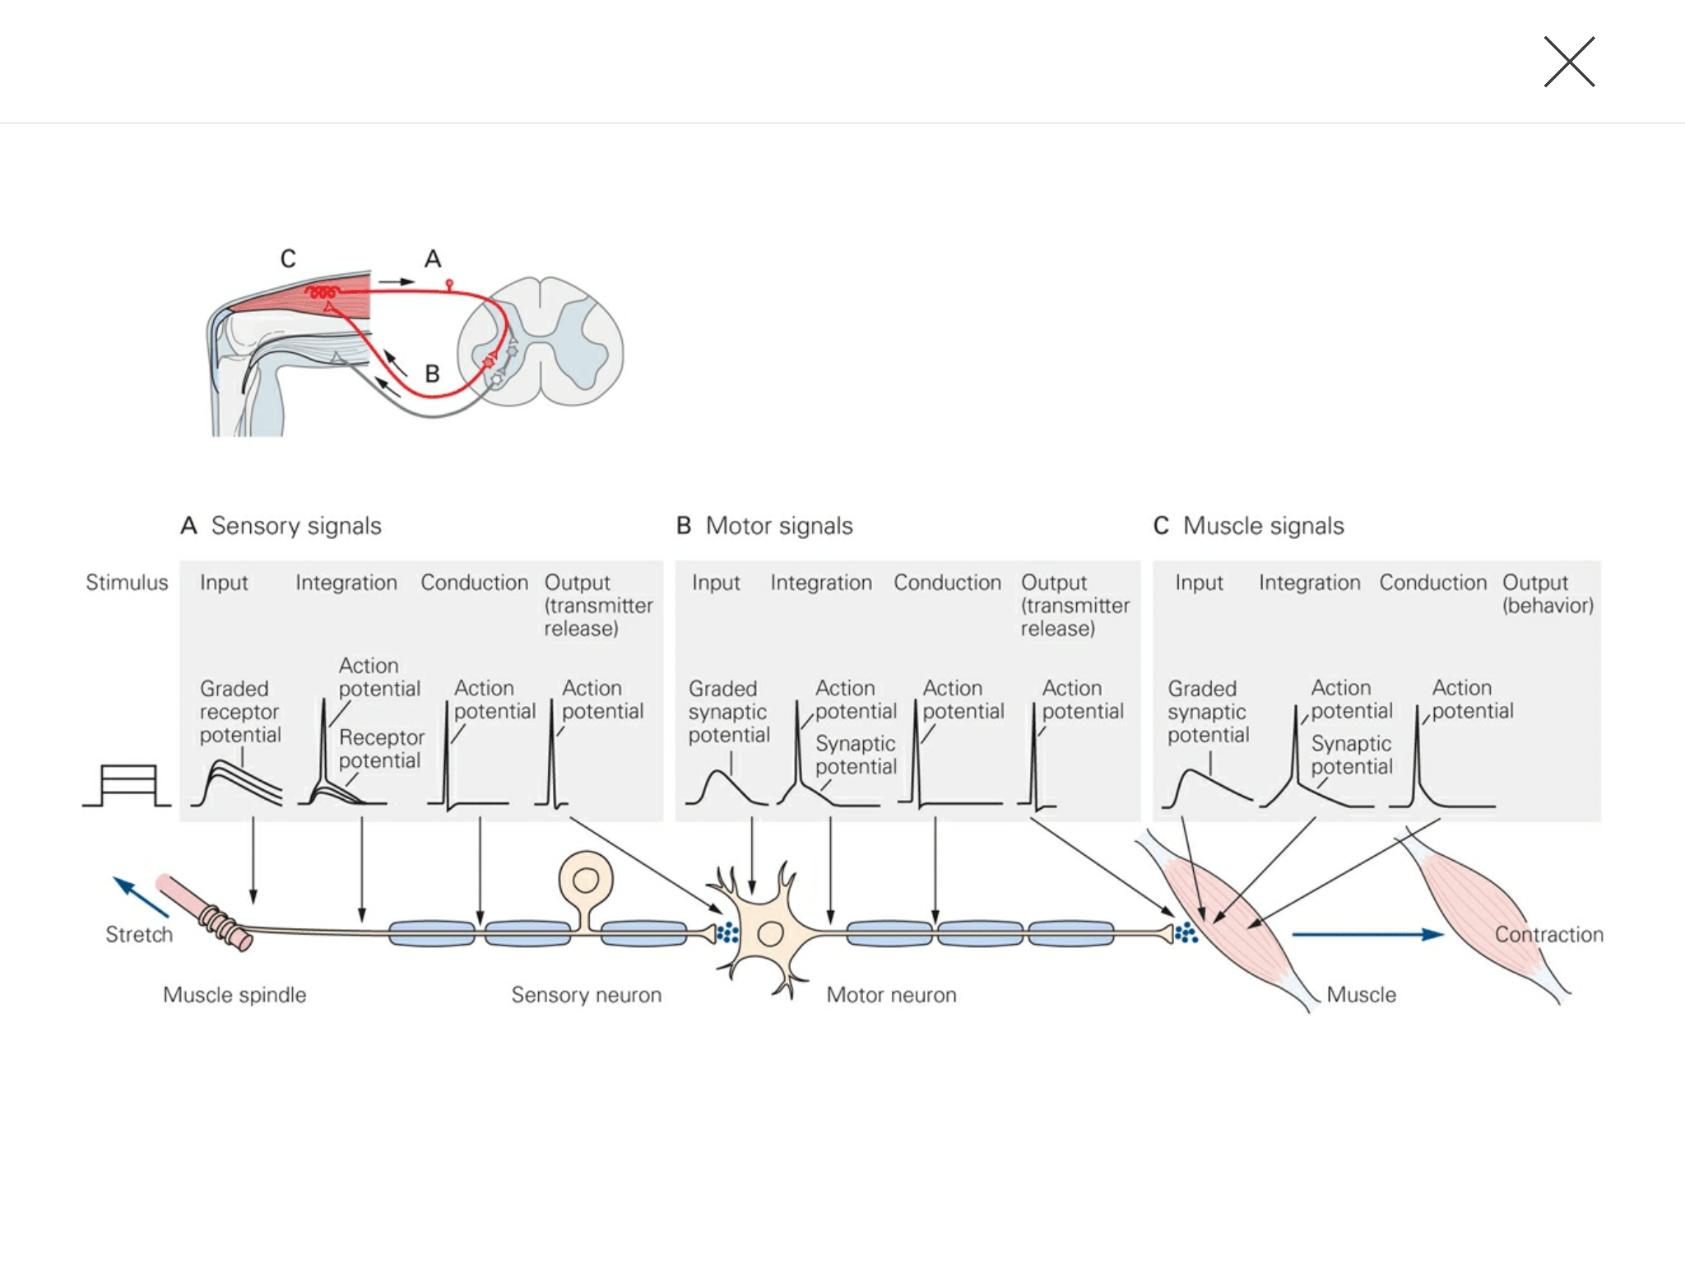
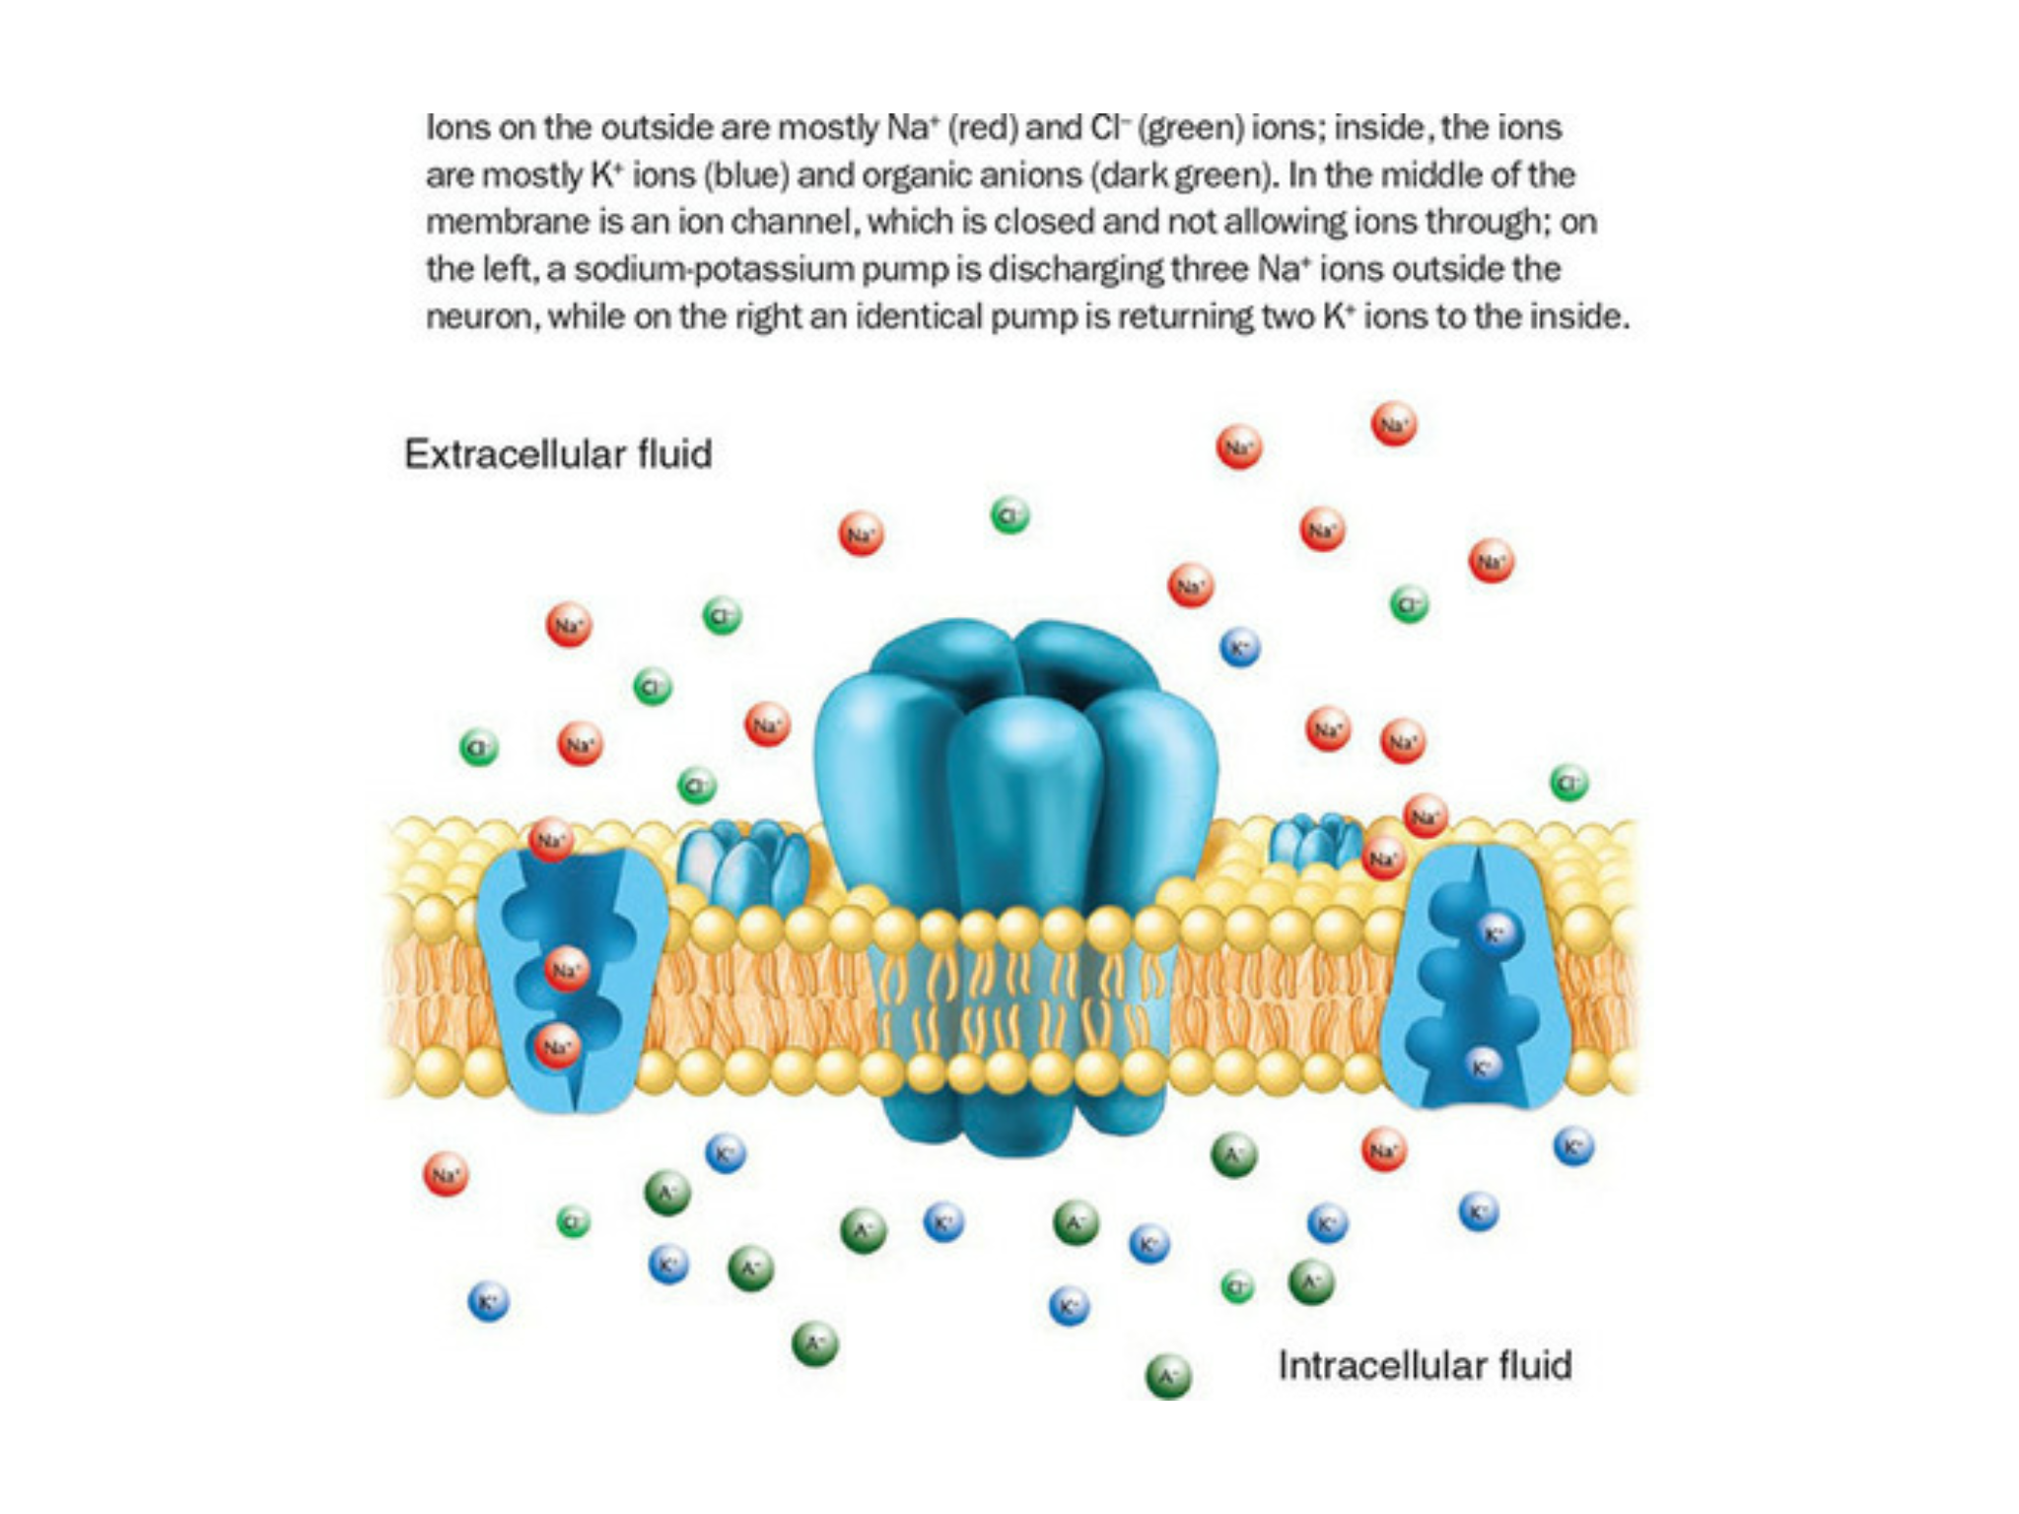

Slide 17
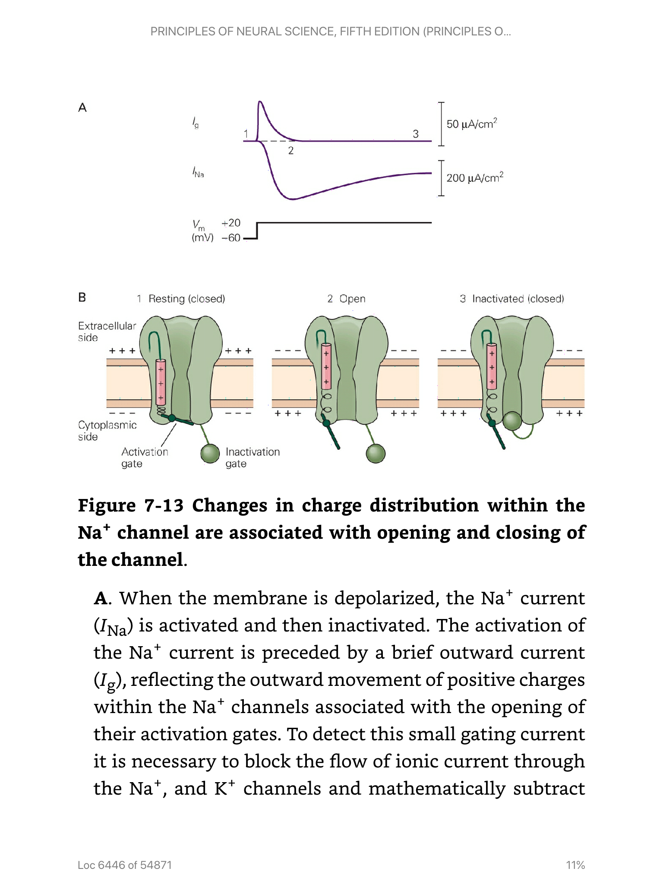
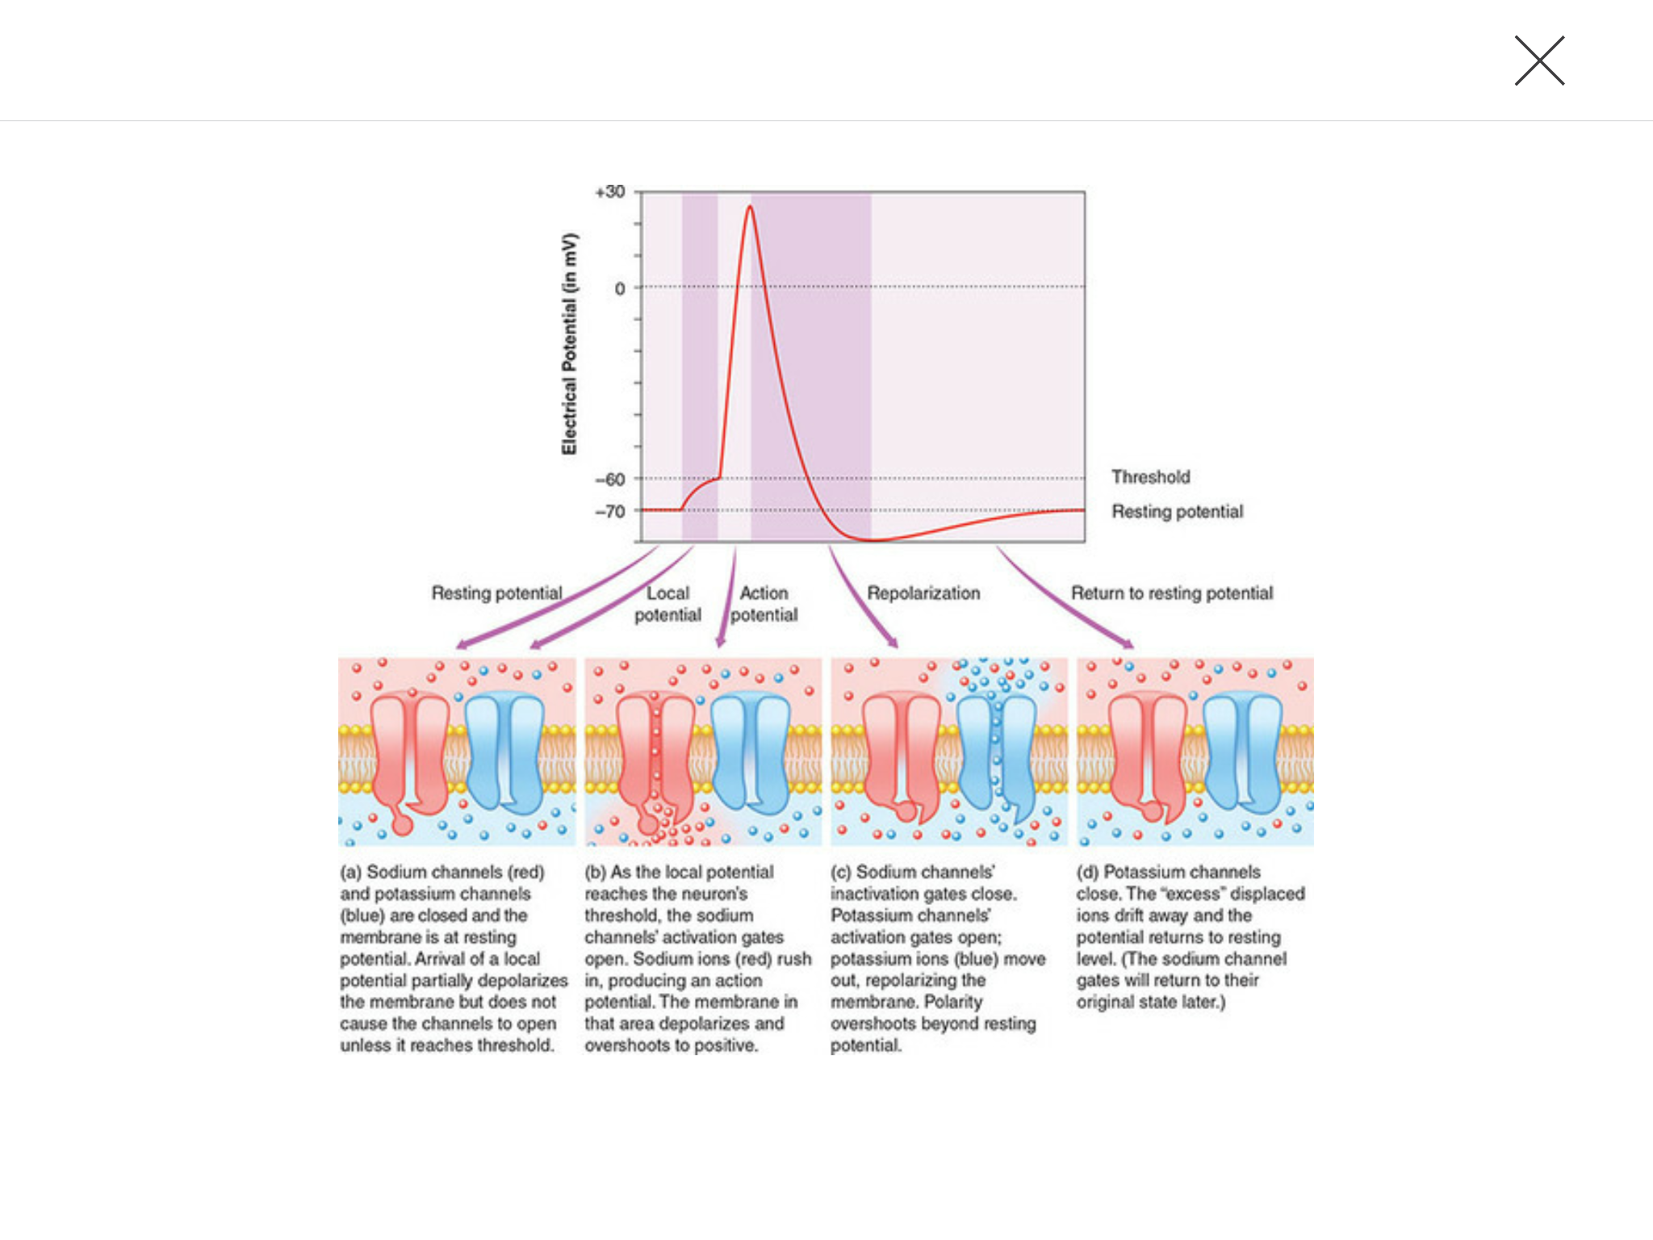
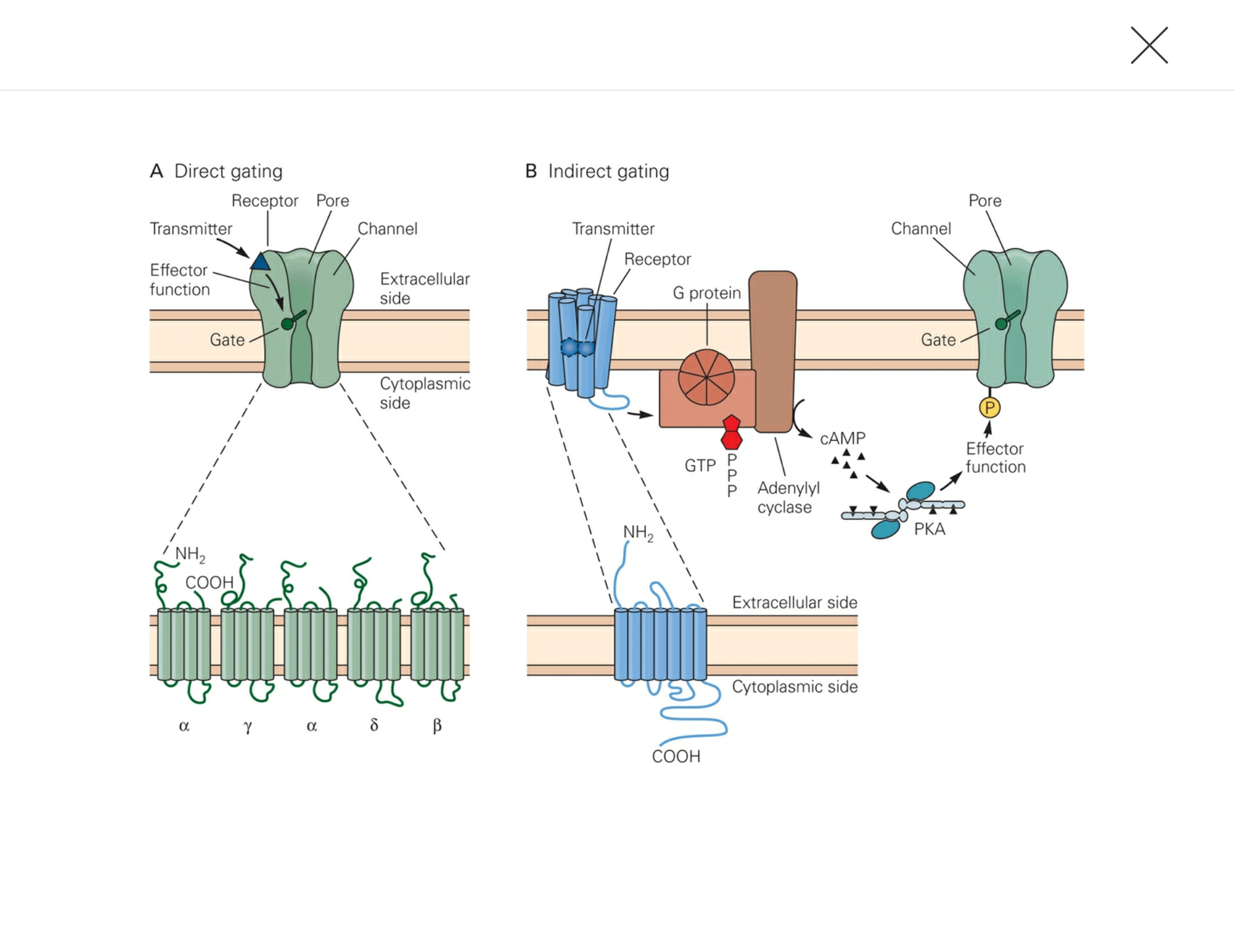
Removed Images

Slide 18
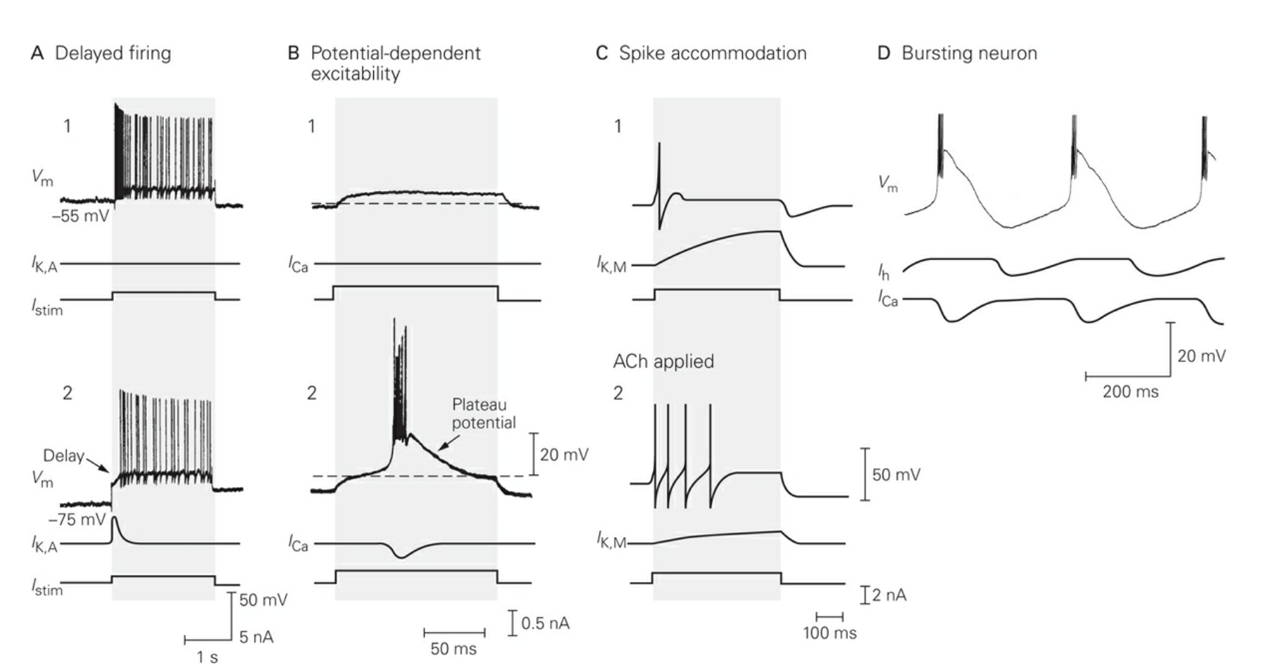
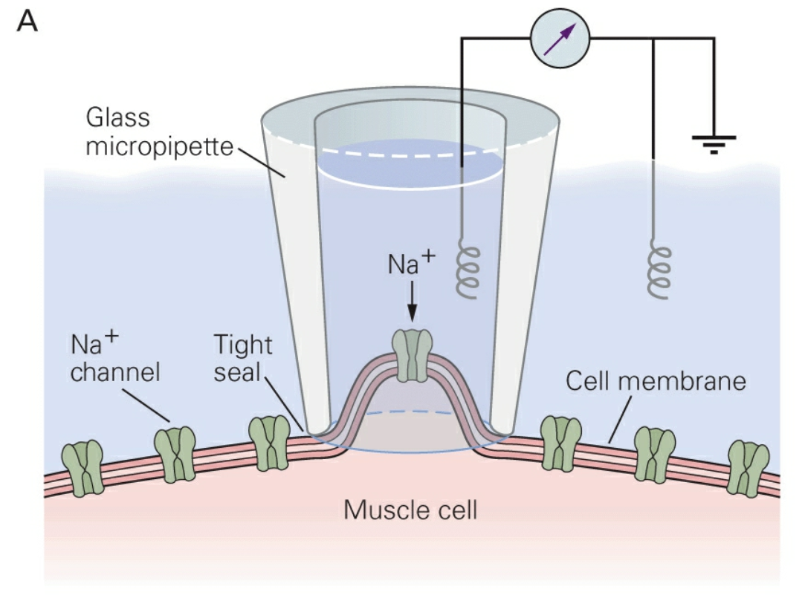
x

Slide 19
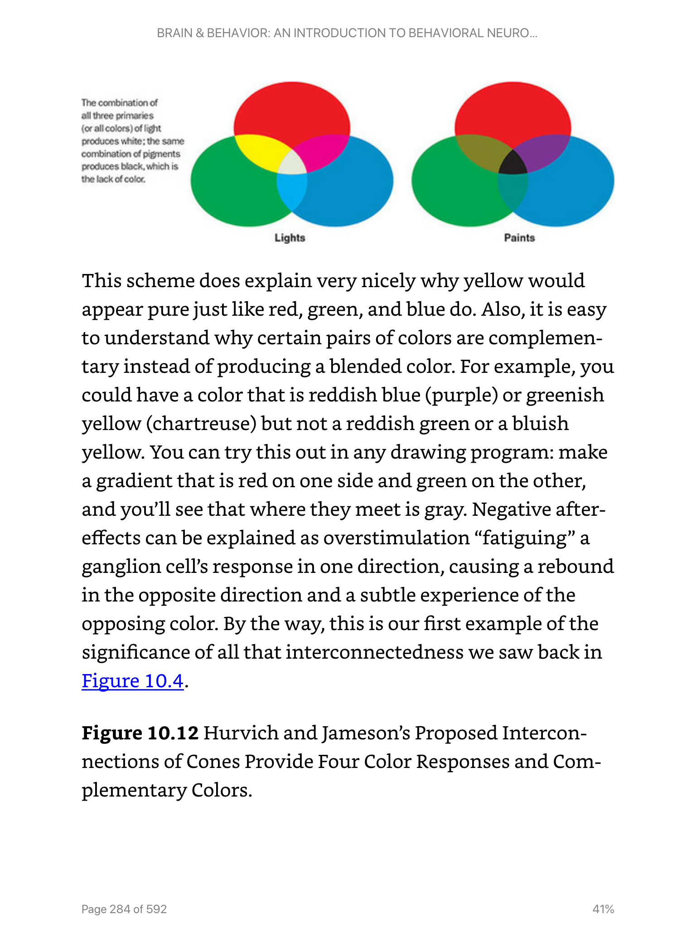
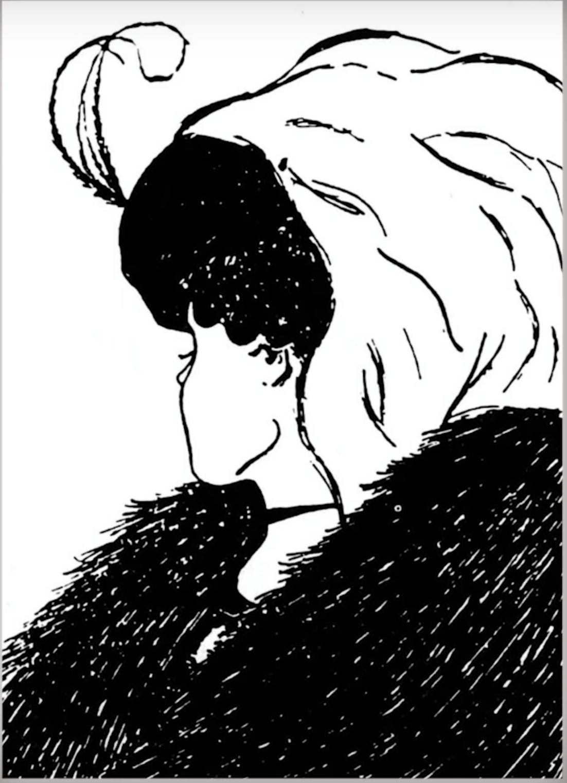
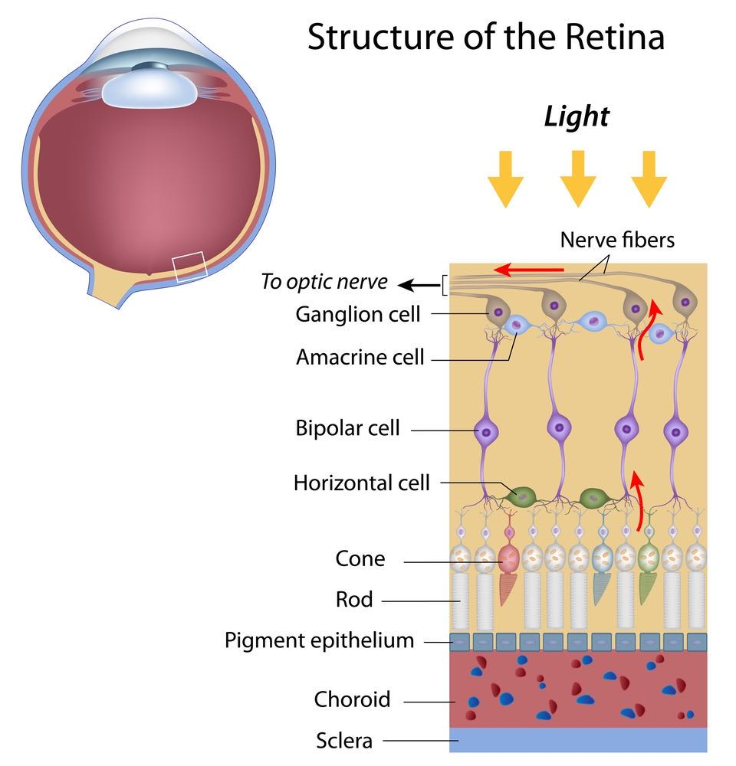
Human Vision and Visual Perception is Constructed By Your Brain

Slide 20
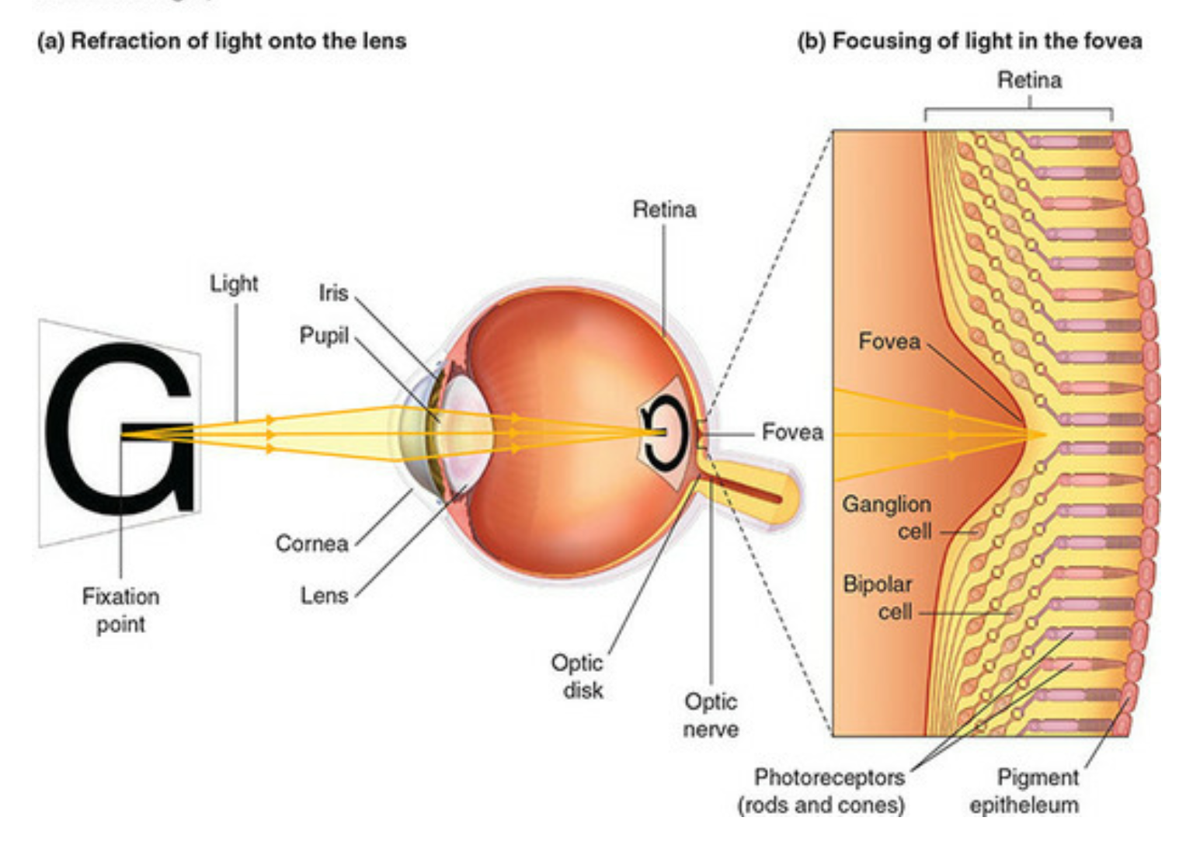
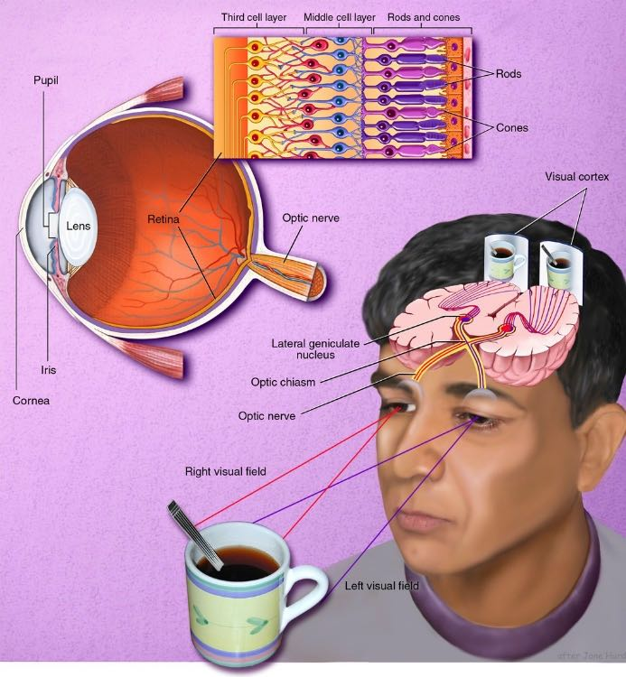
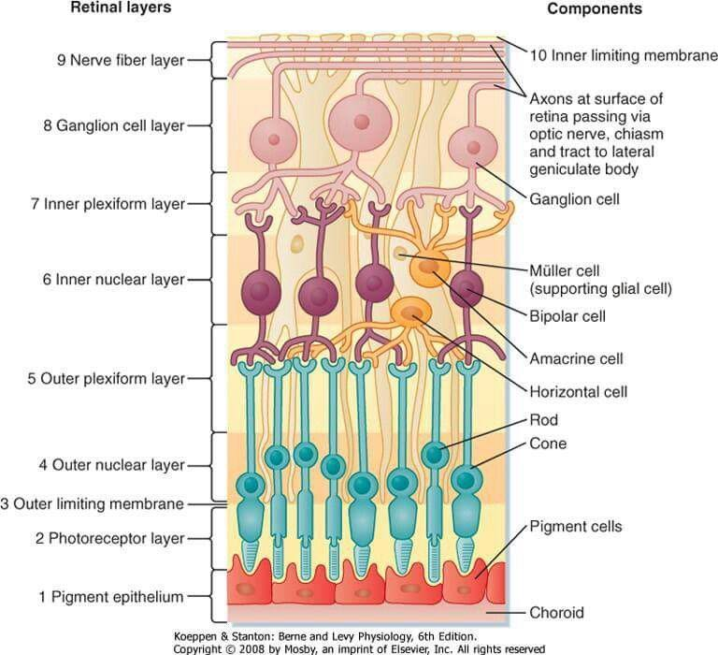
The Retina has a complex multi-cellular structure

Slide 21
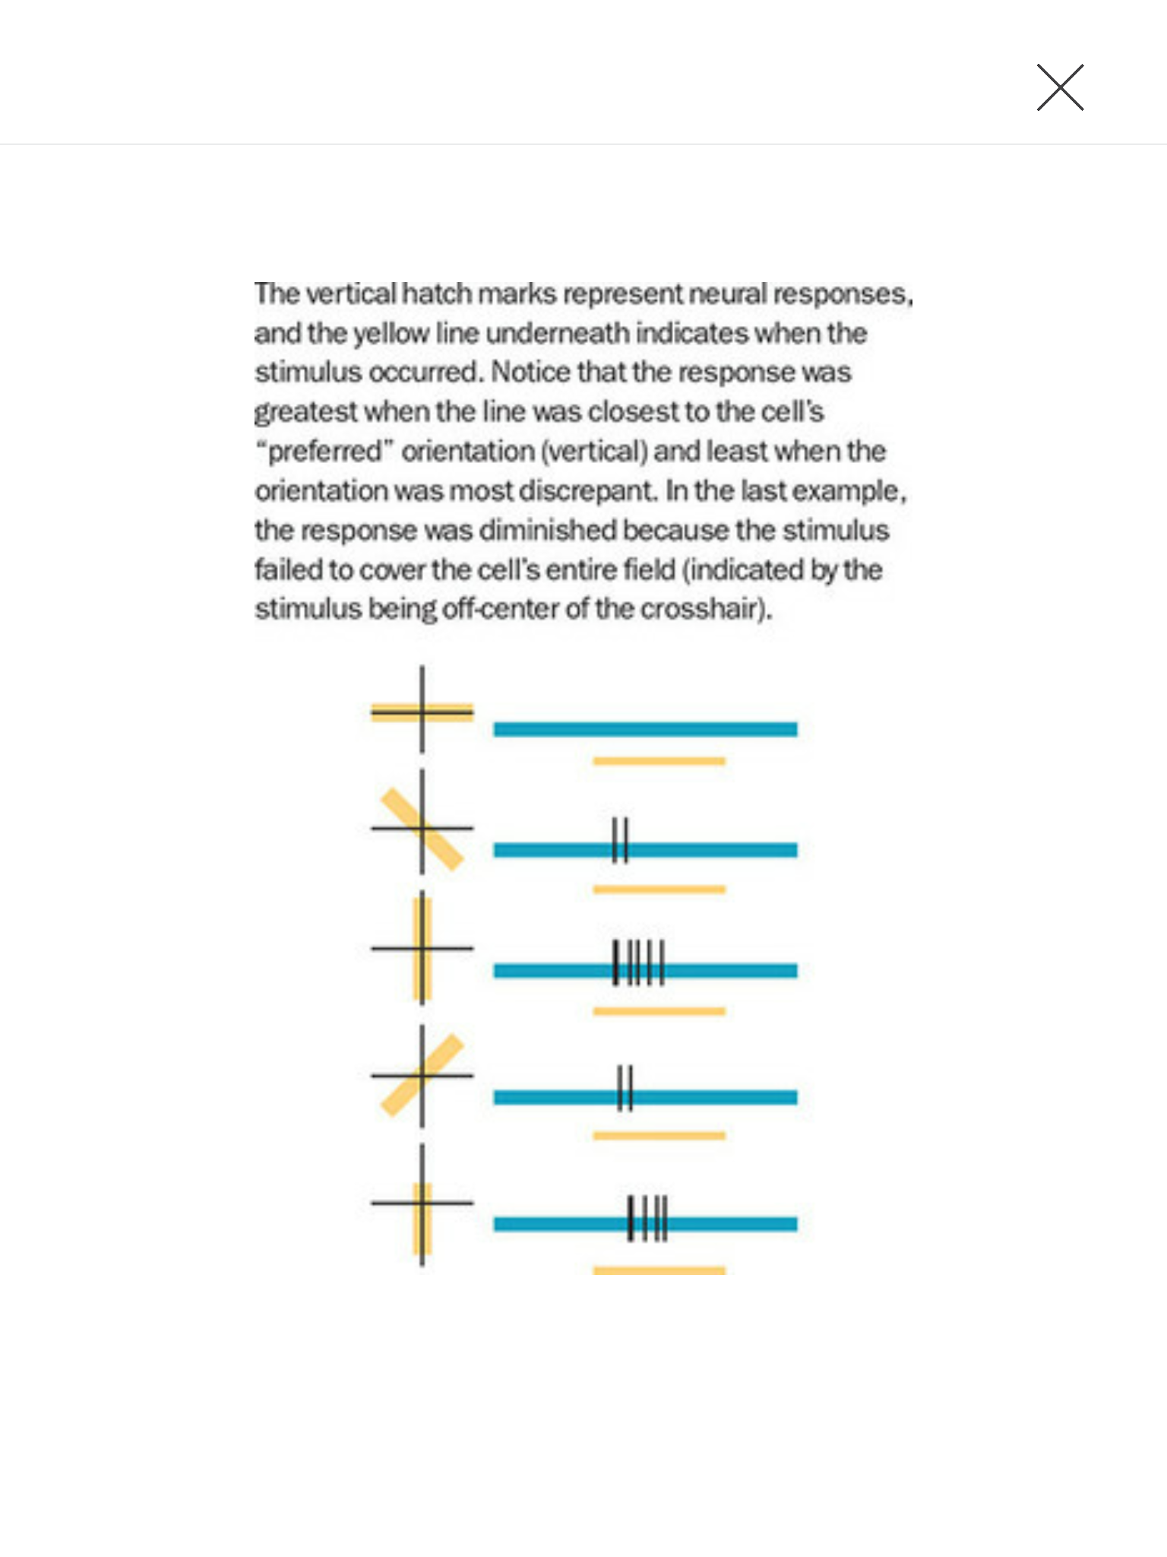
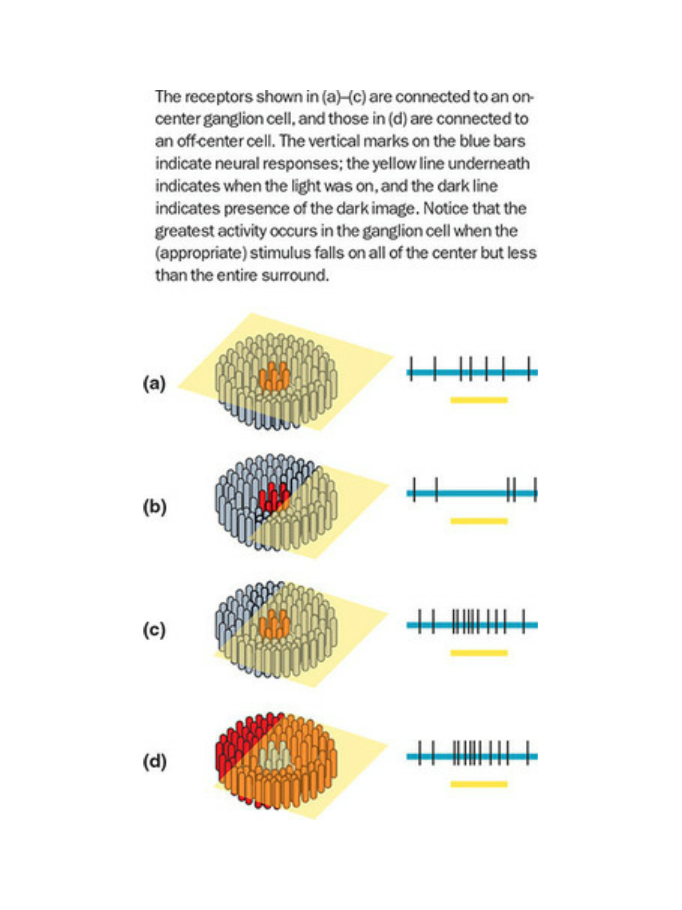
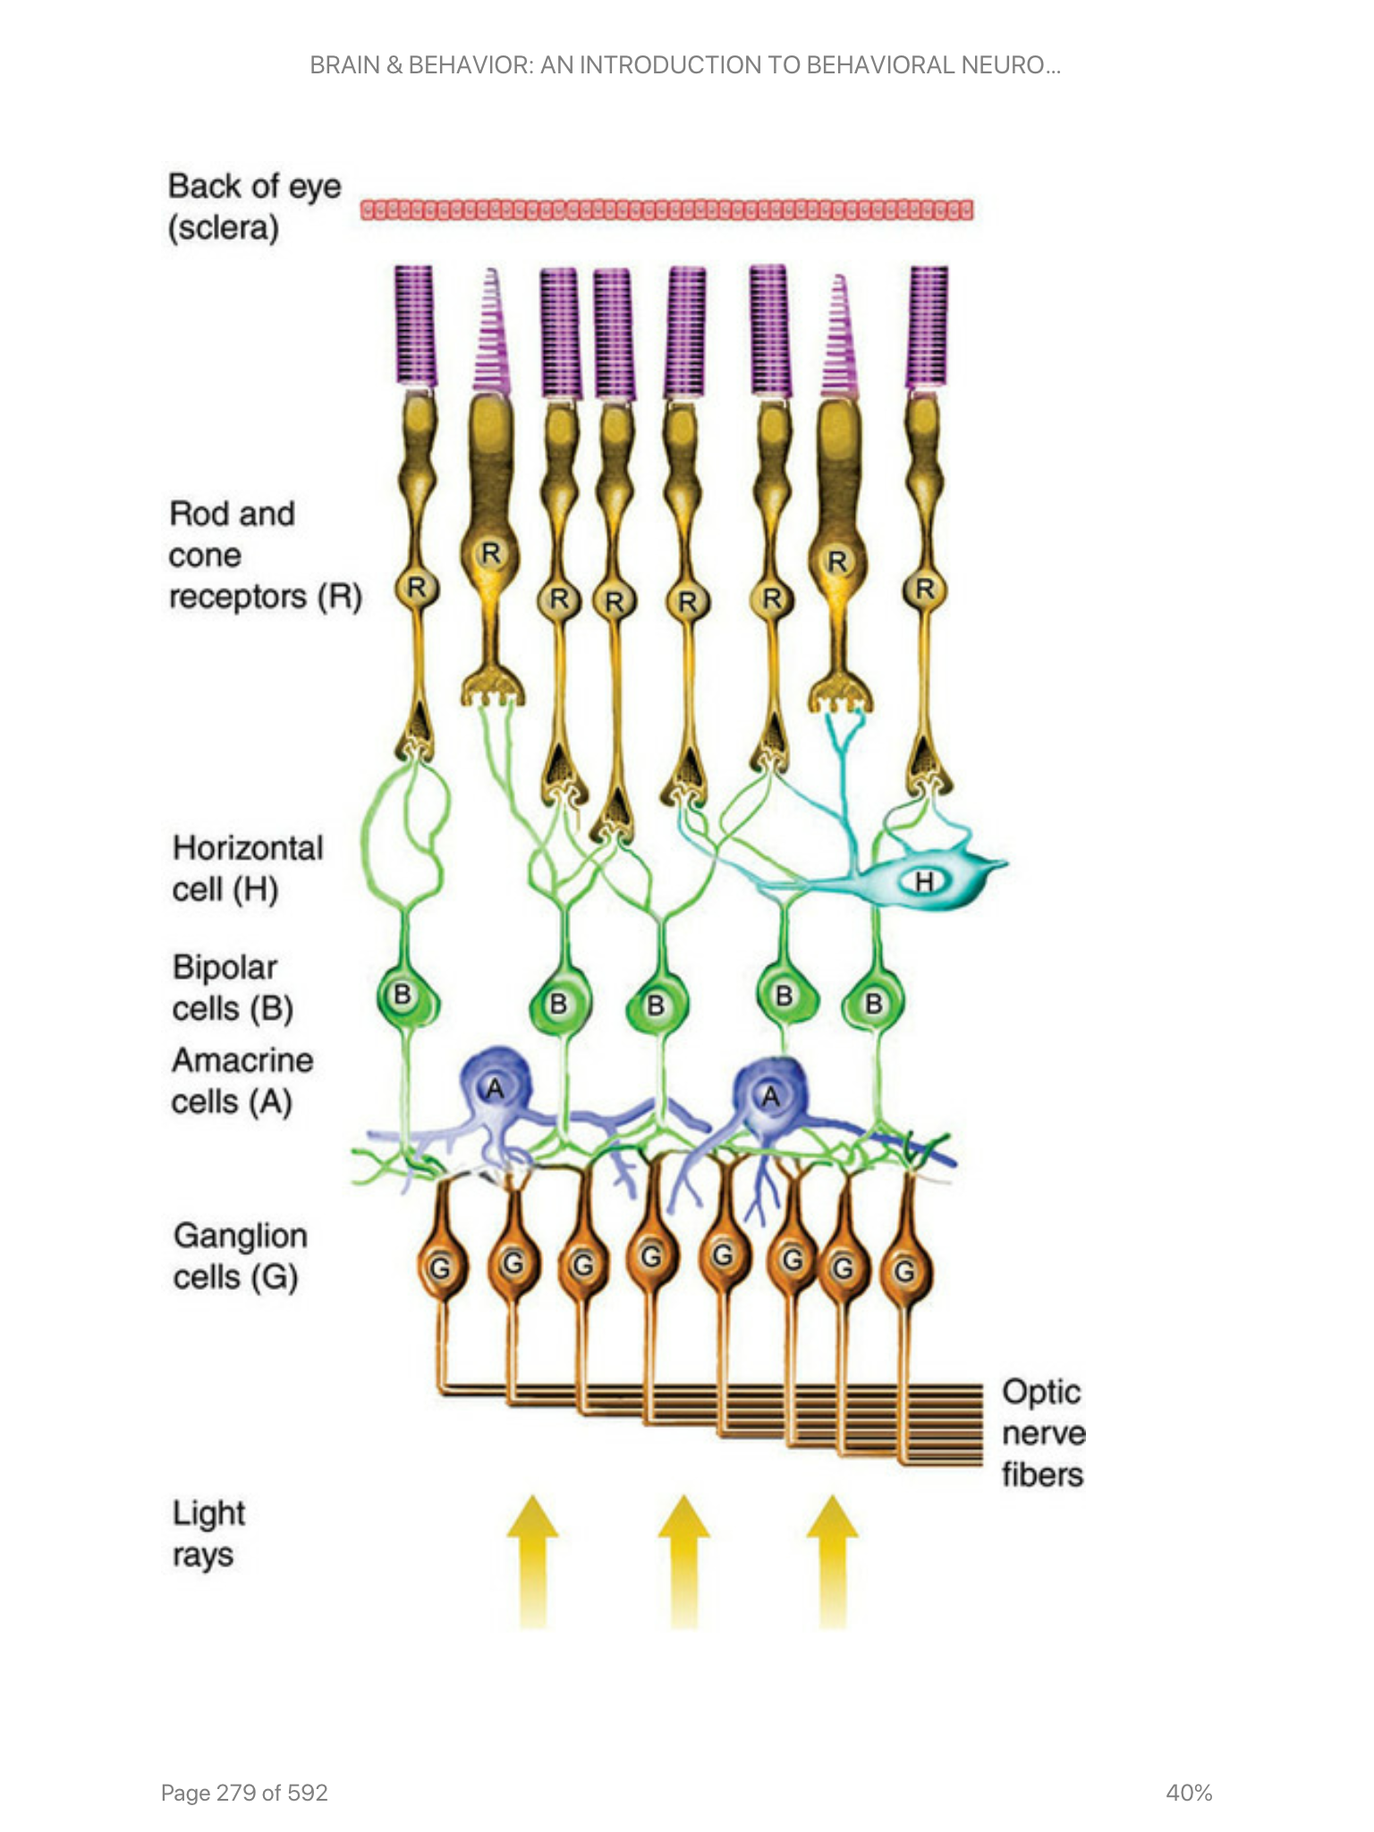
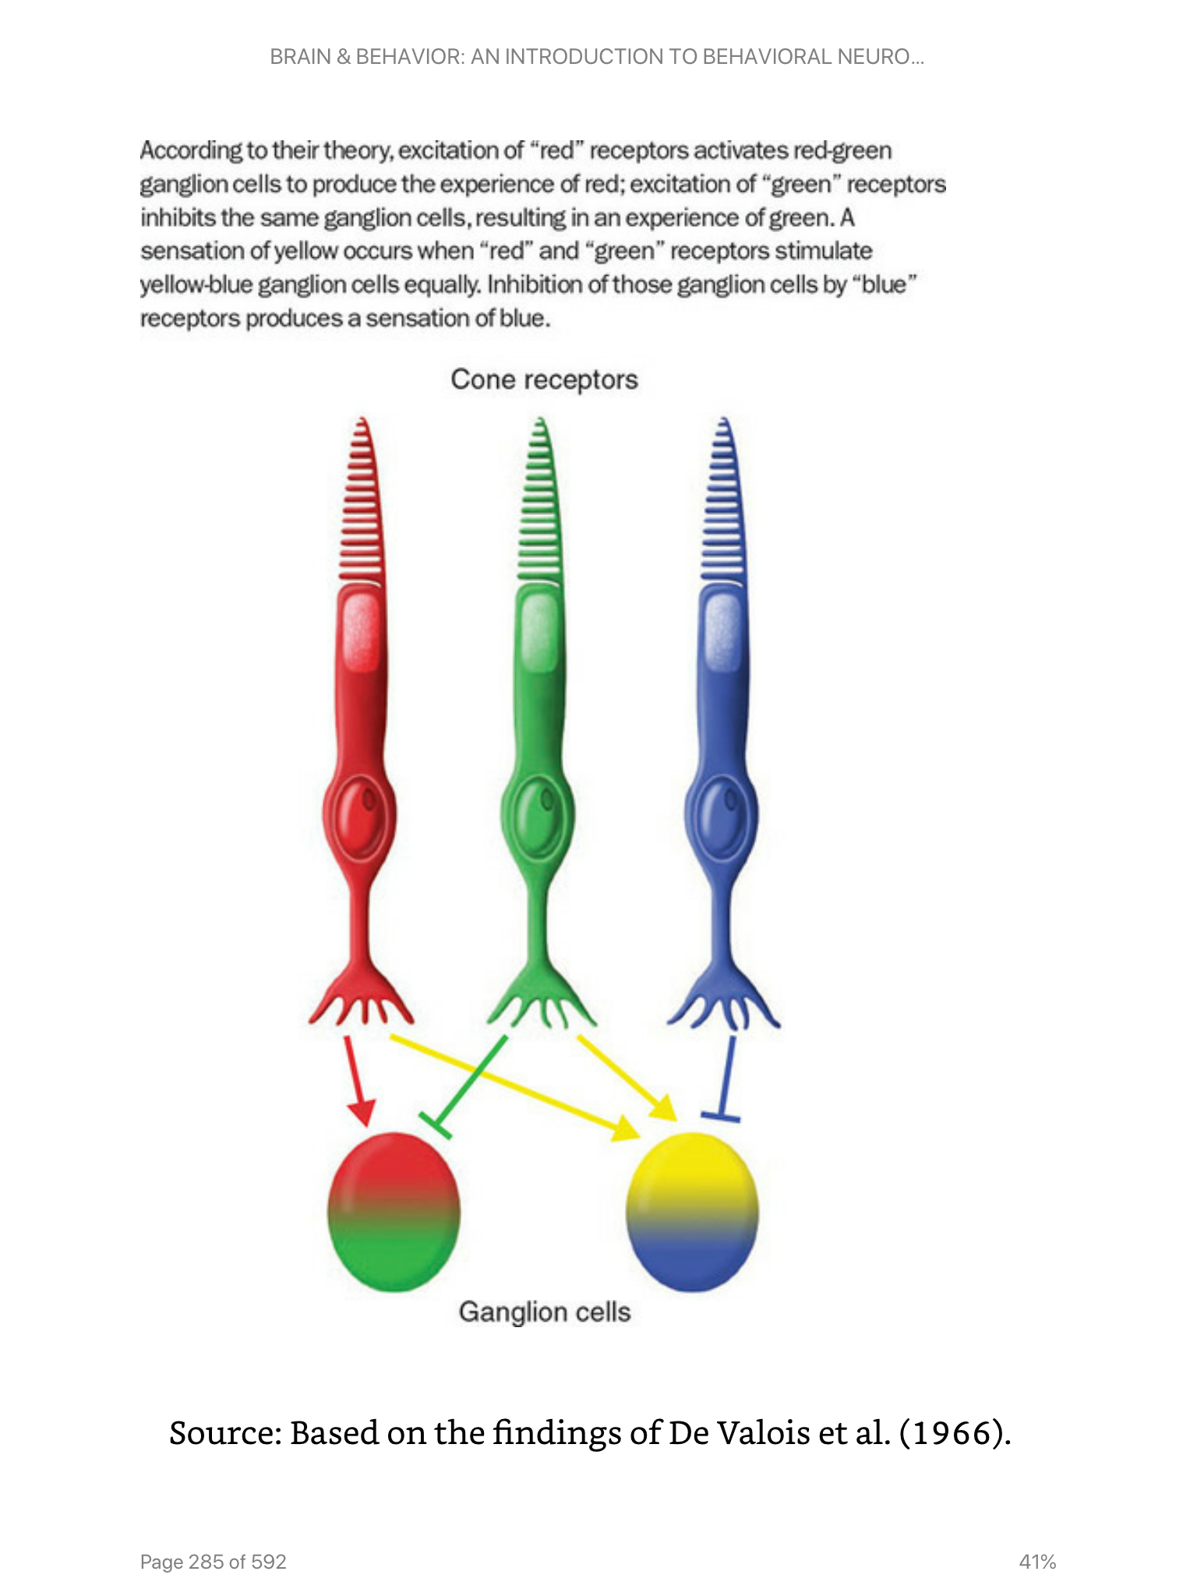
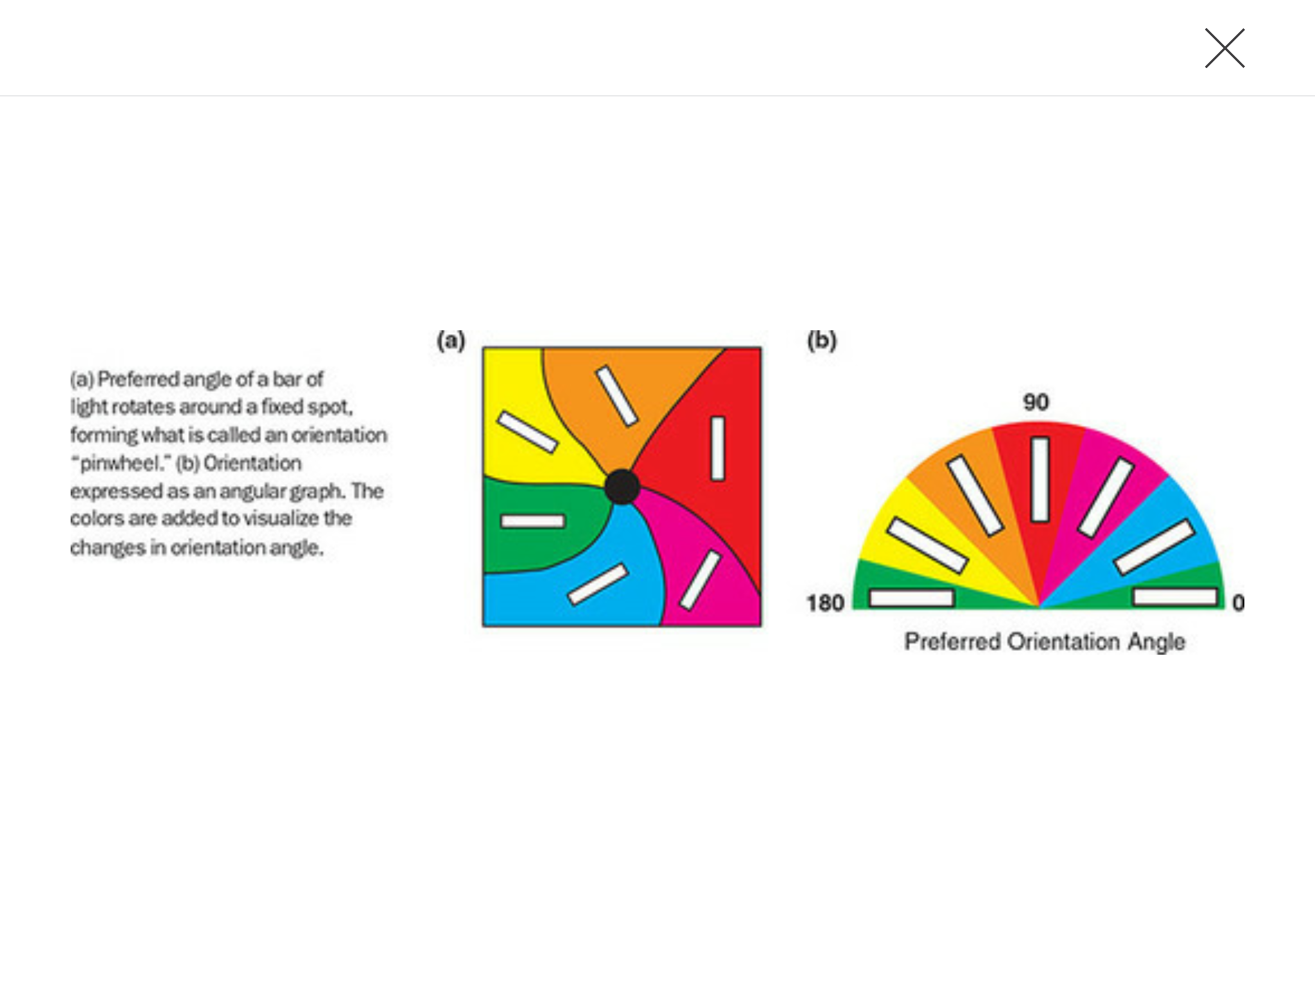
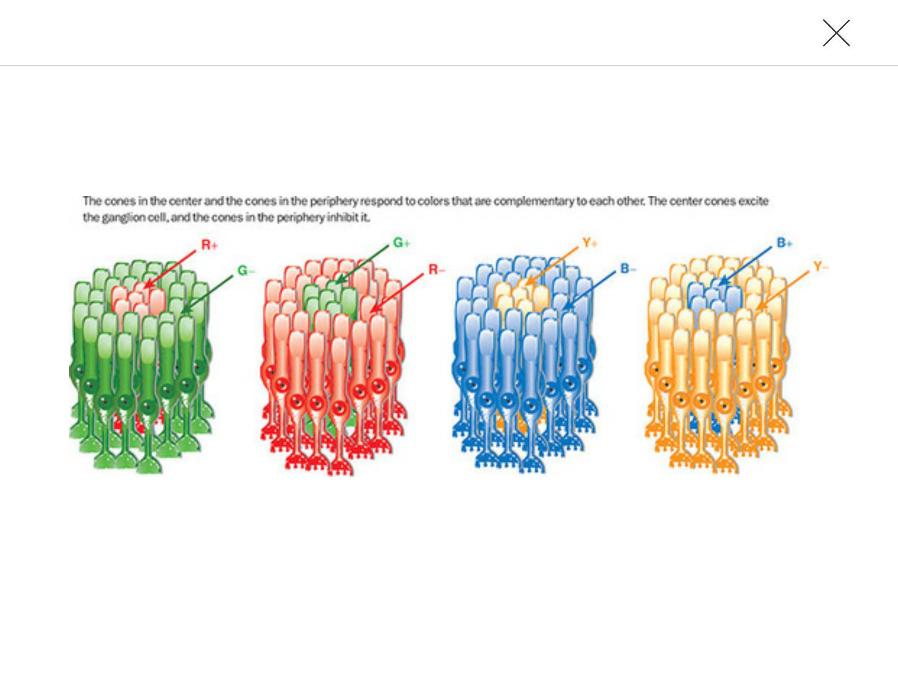
Retina Cells Respond to Specific Patterns/Colors/Angles

Slide 22
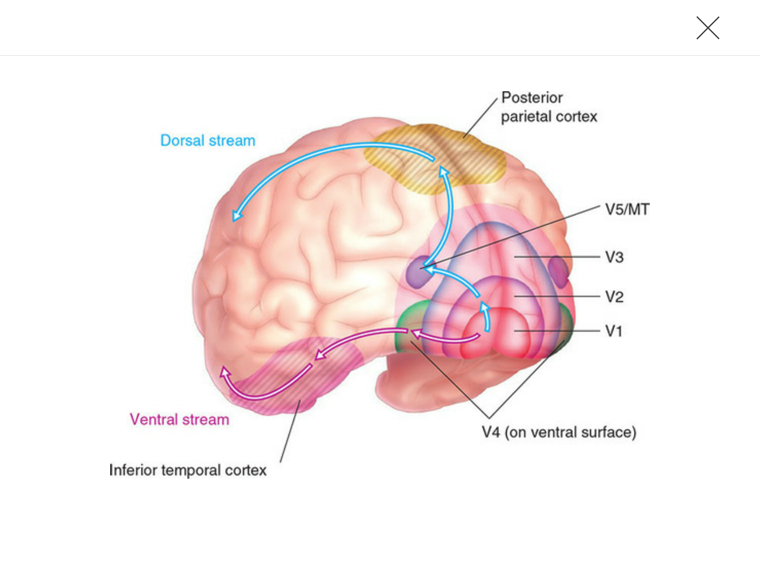
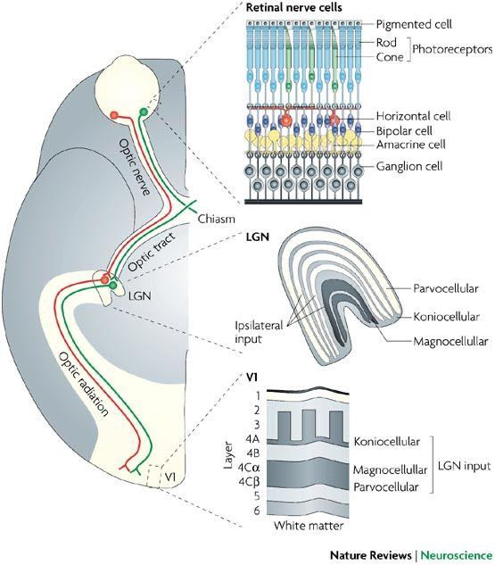
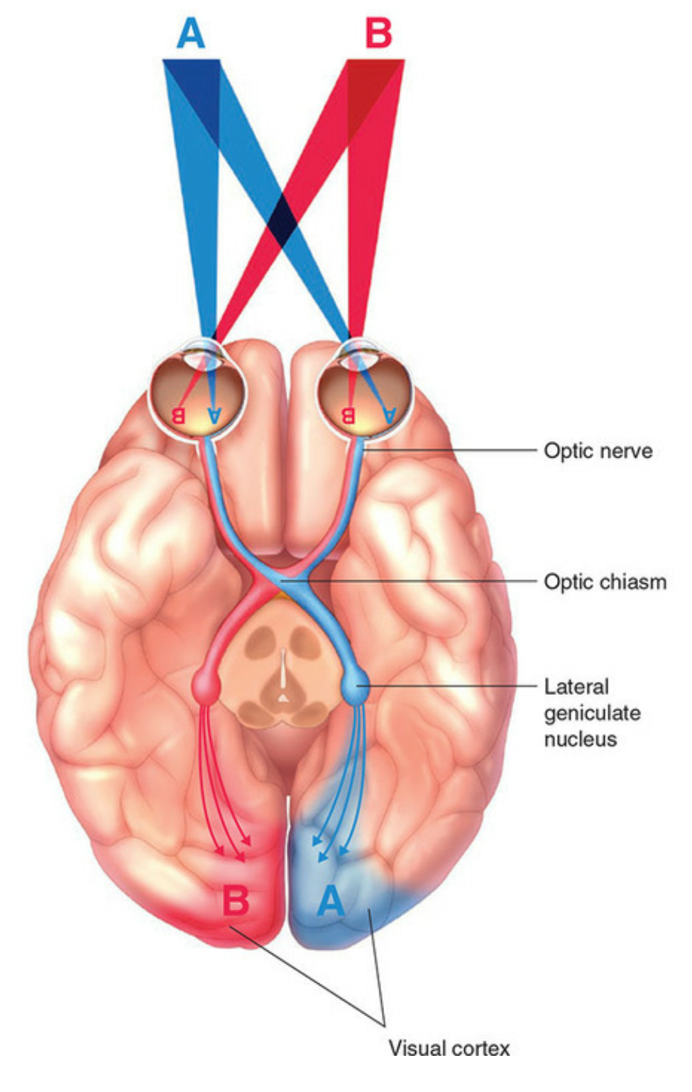
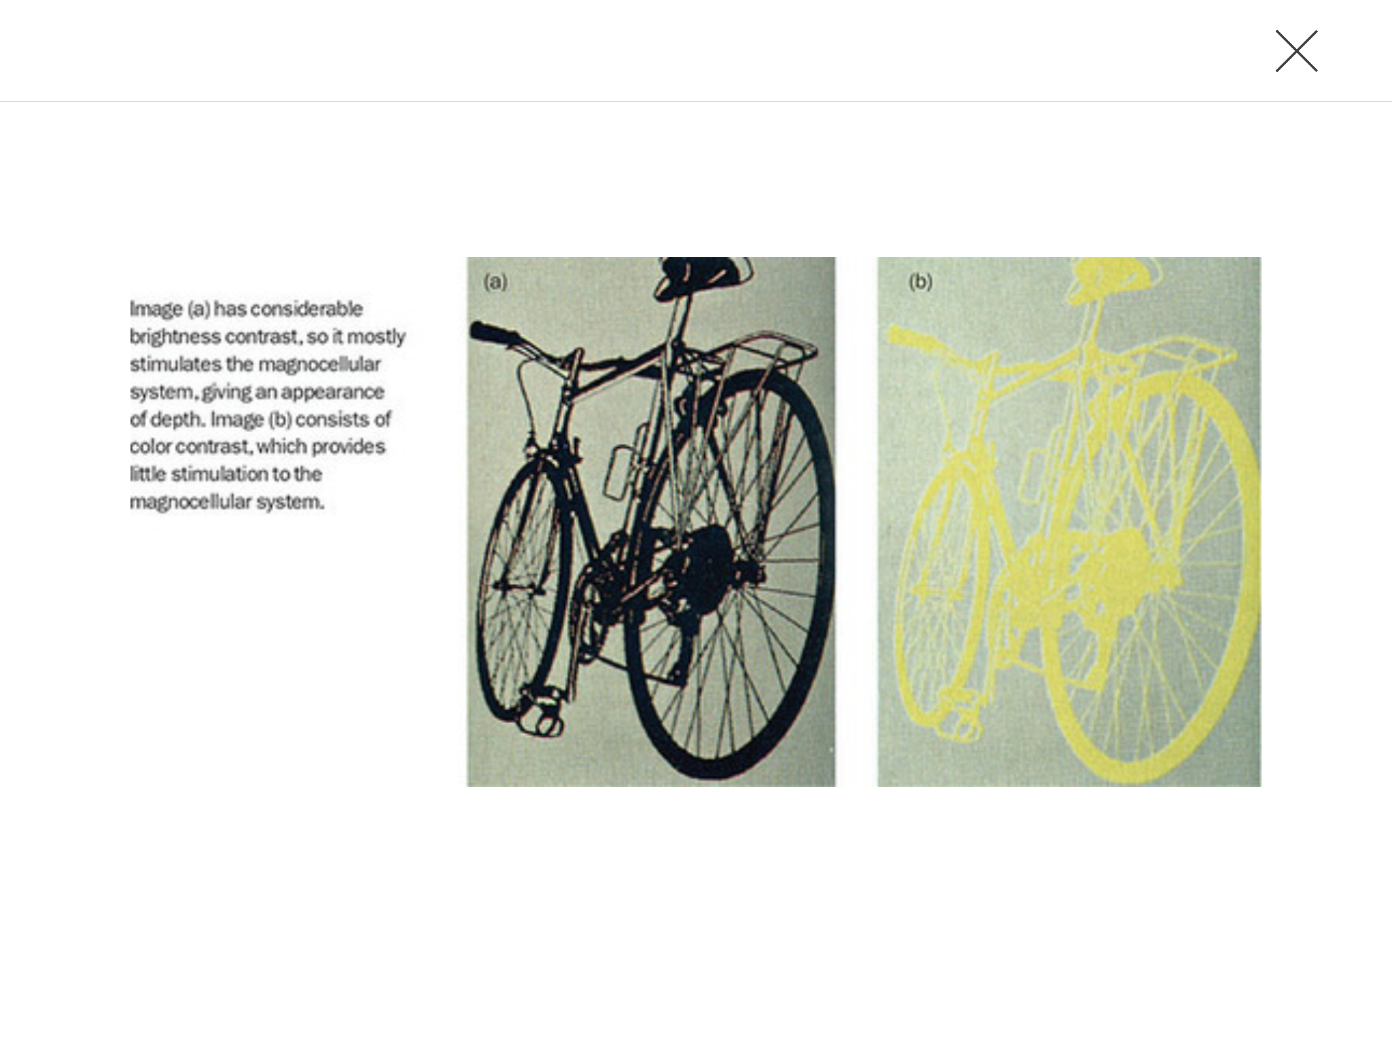
Info about Color/Movement/Edges are Processed by Separate Networks in the Brain

Slide 23
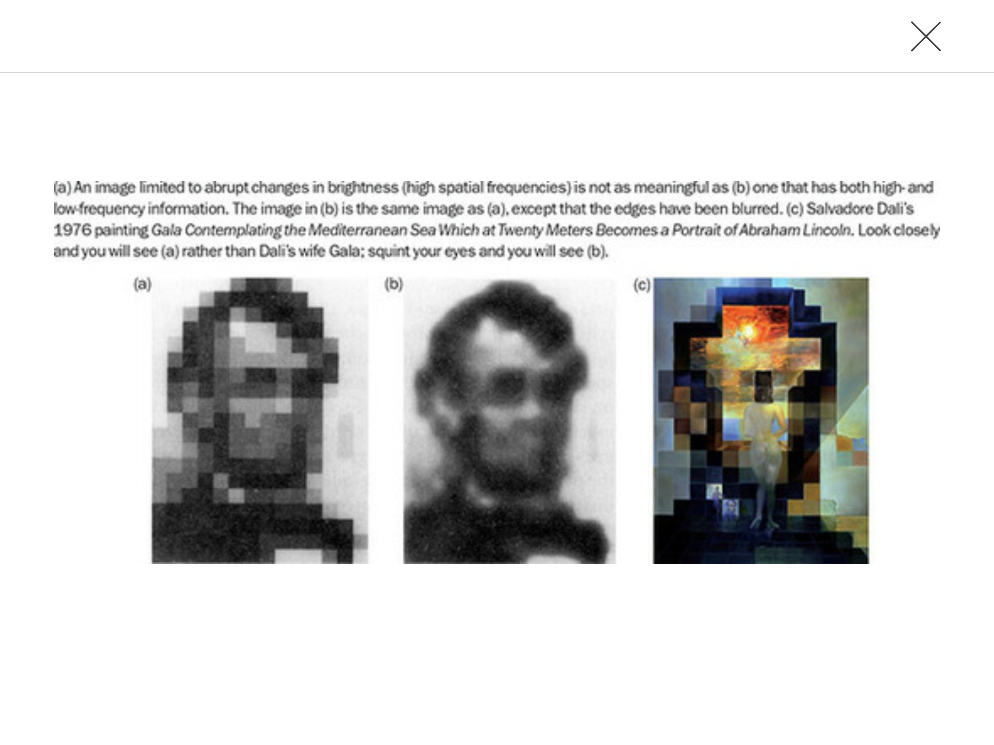
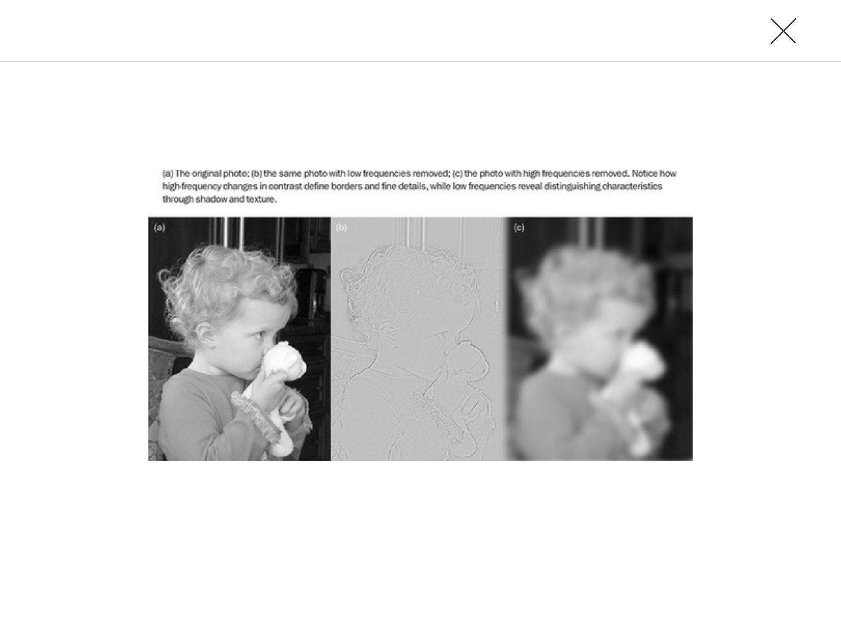

Slide 24
How we See color

Slide 25
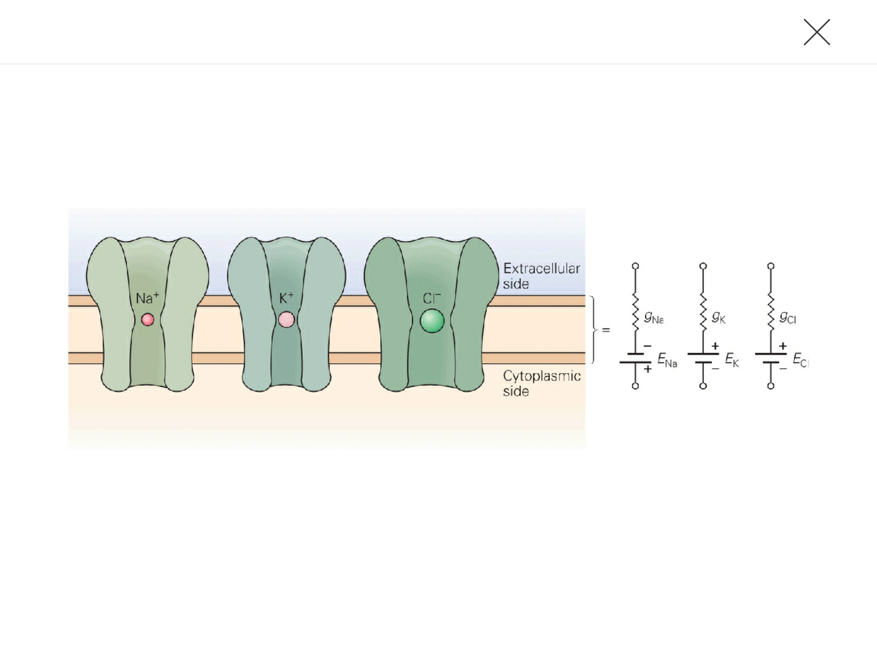
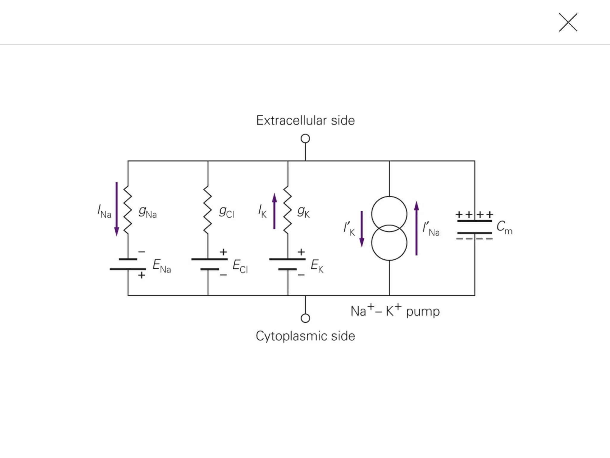

Slide 26
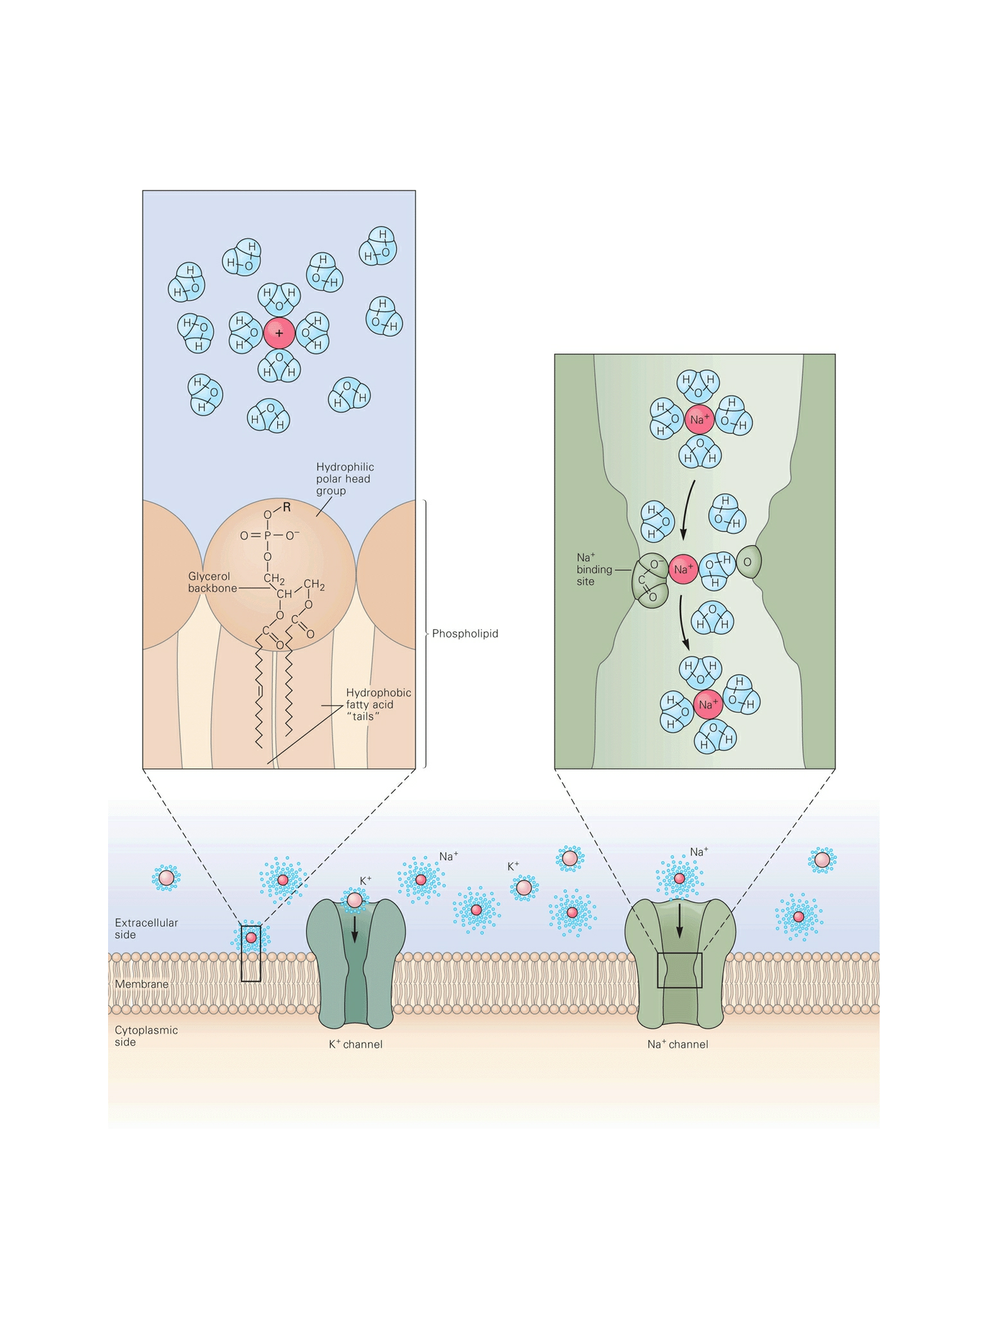
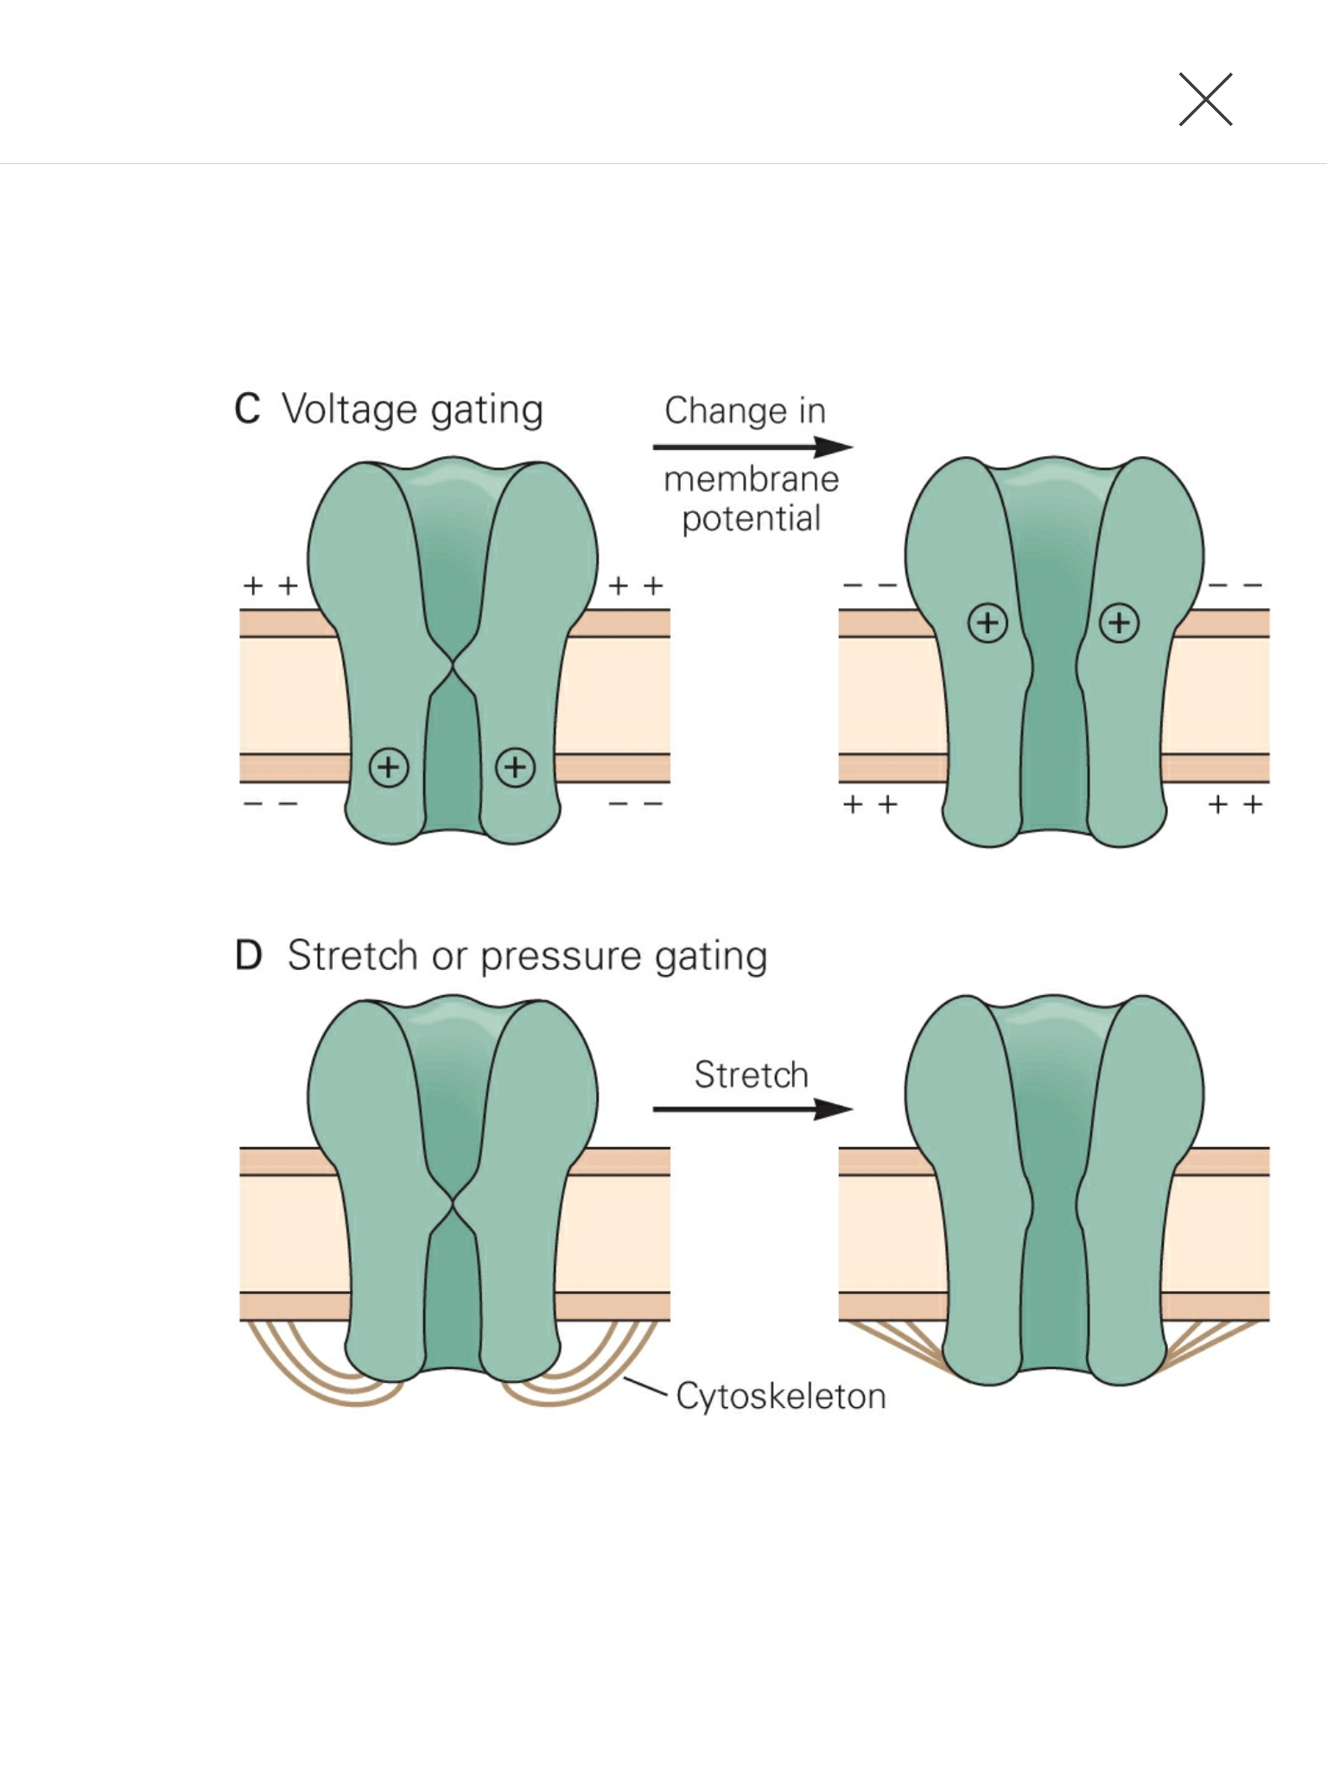
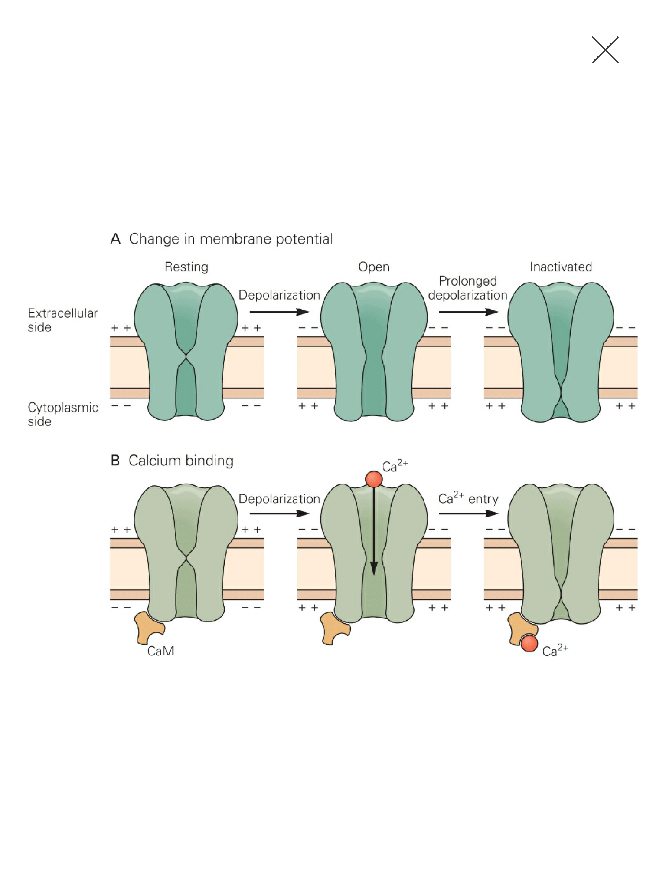
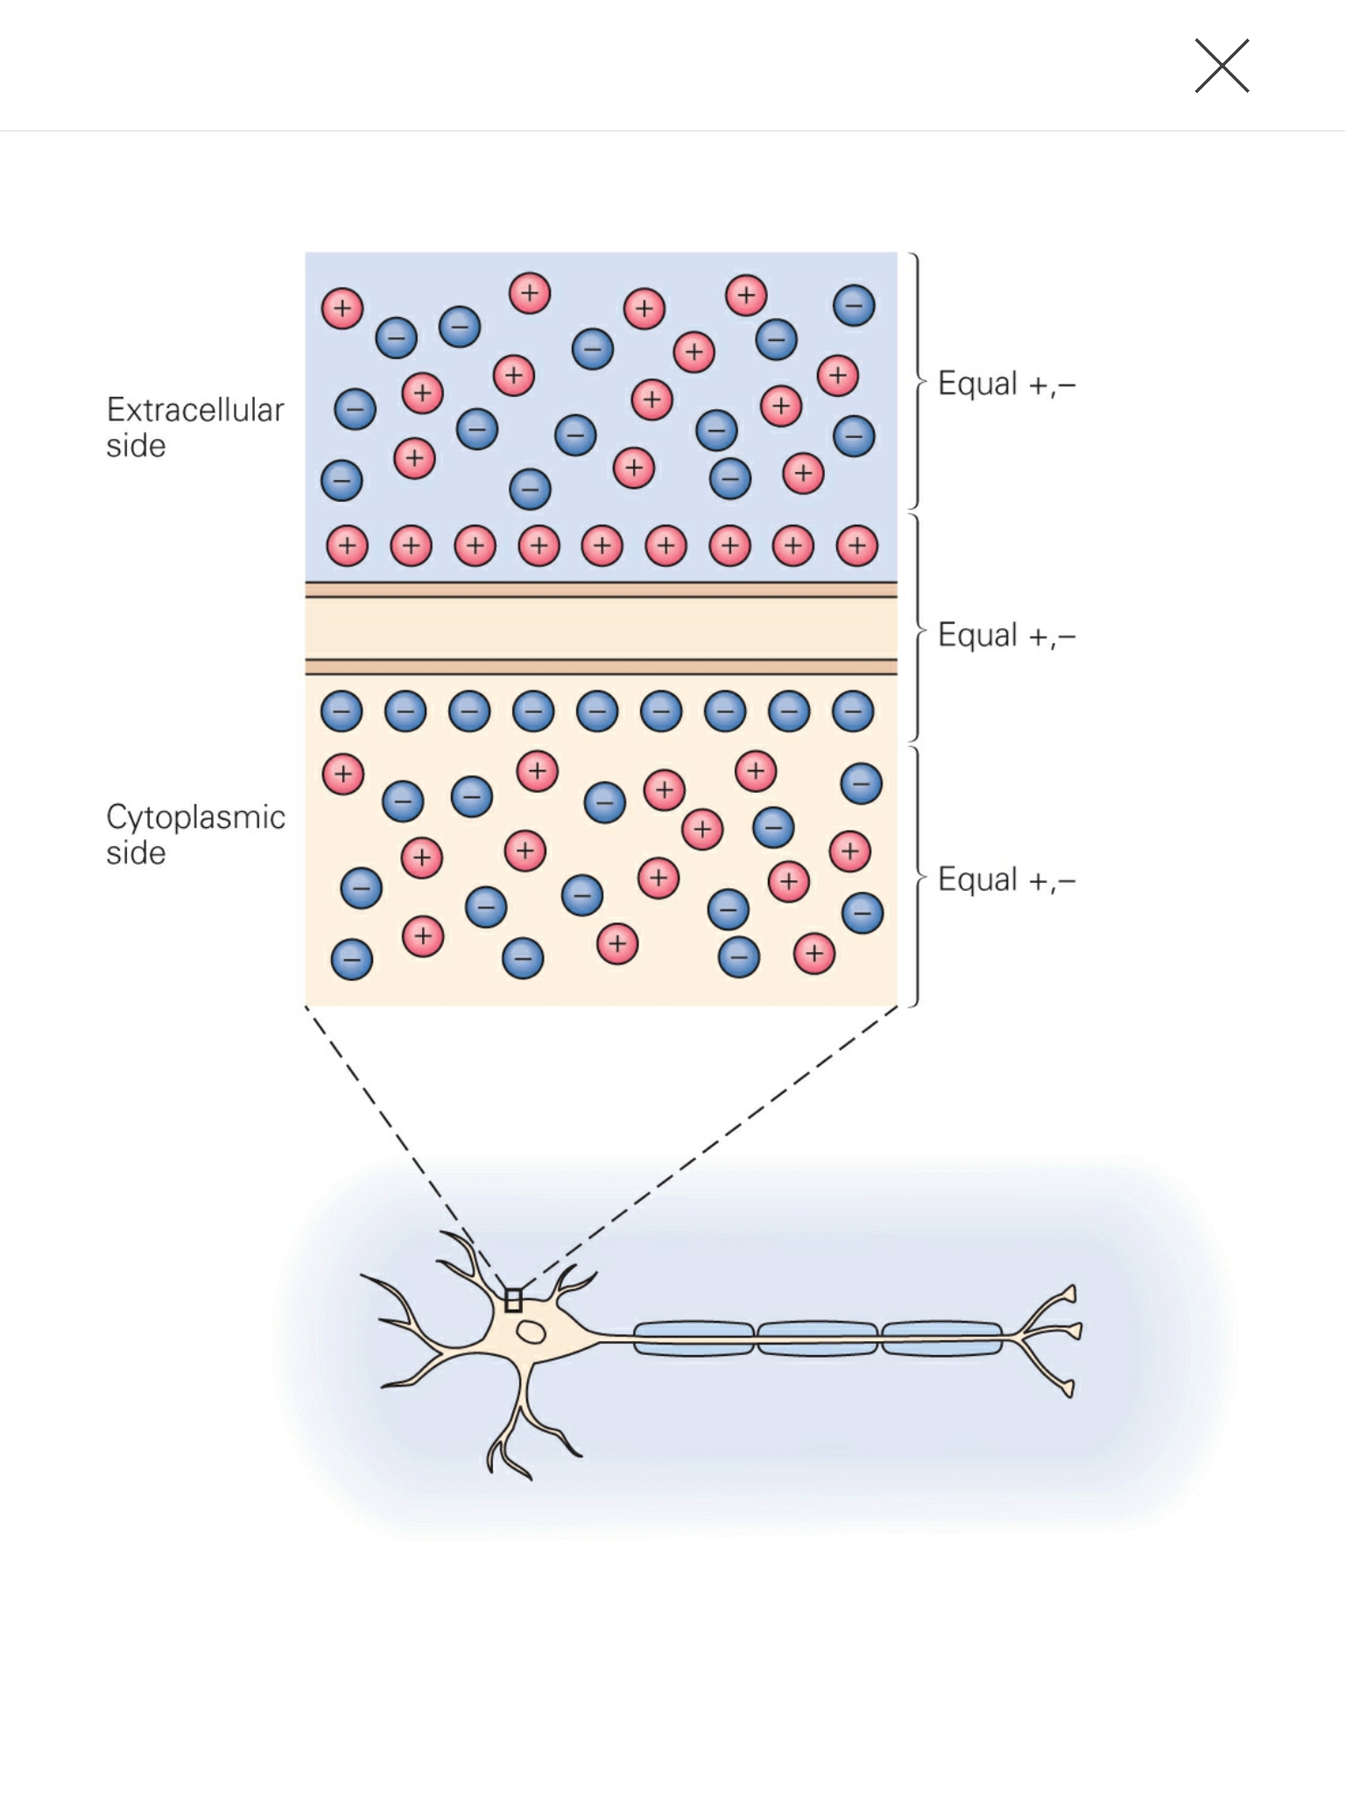
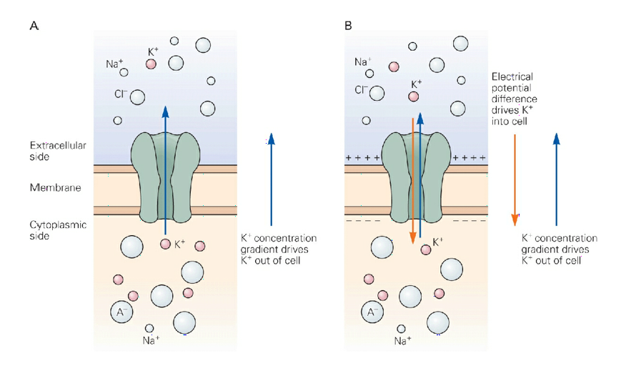

Slide 27
